Slide 1
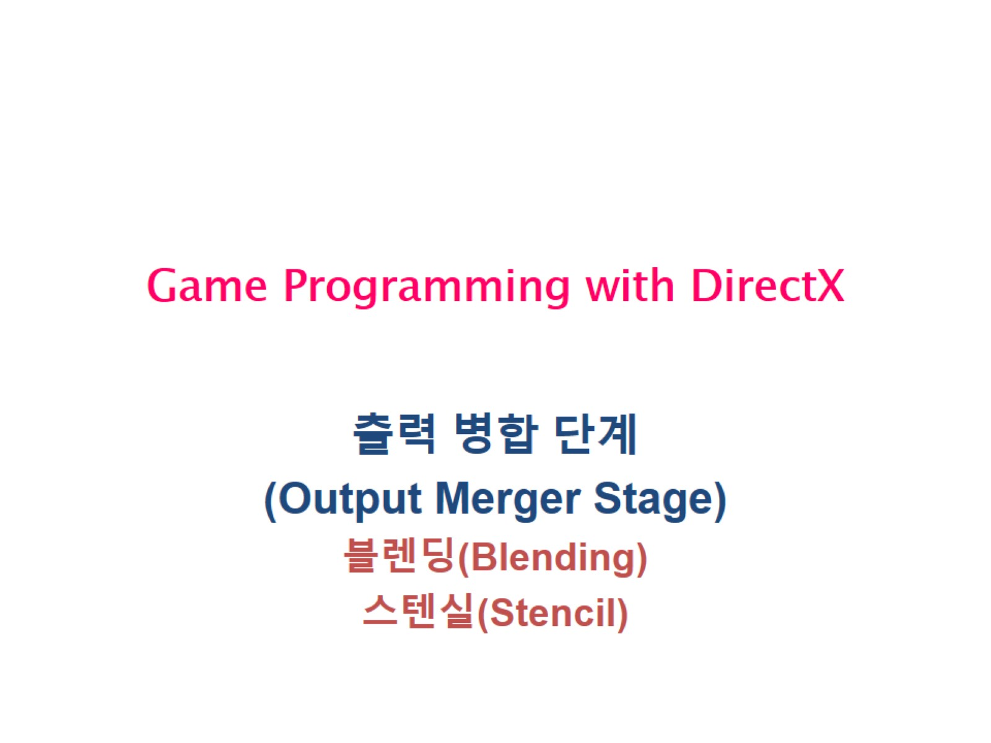
Game Programming with DirectX

Slide 2
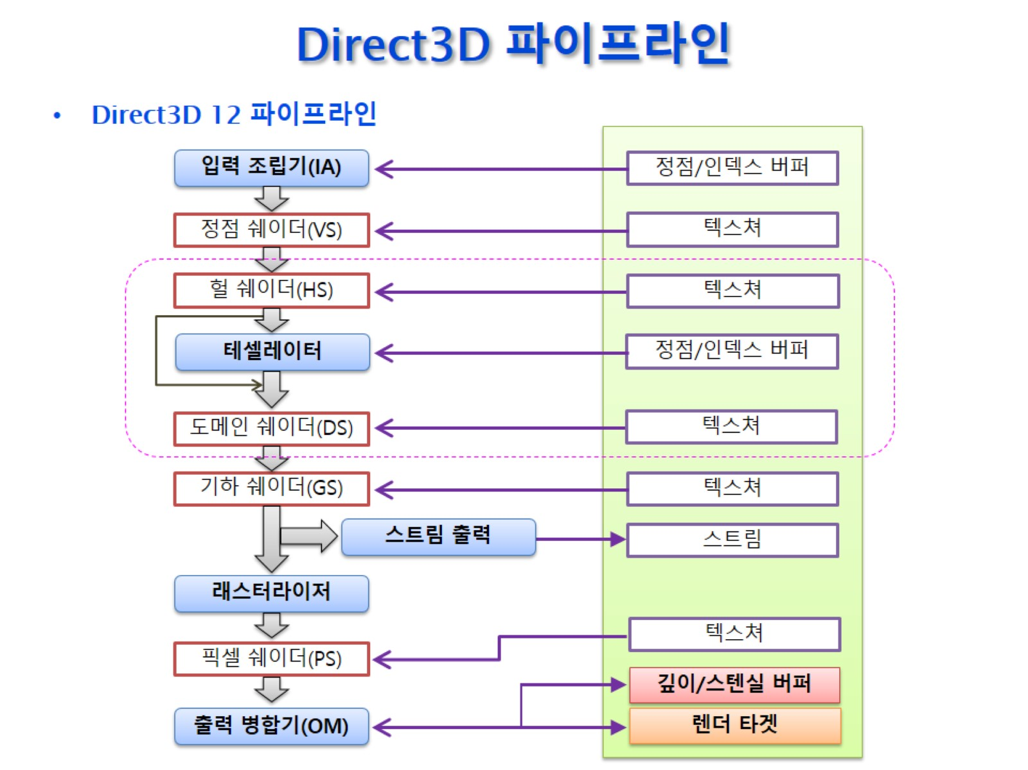
Direct3D 파이프라인

Slide 3
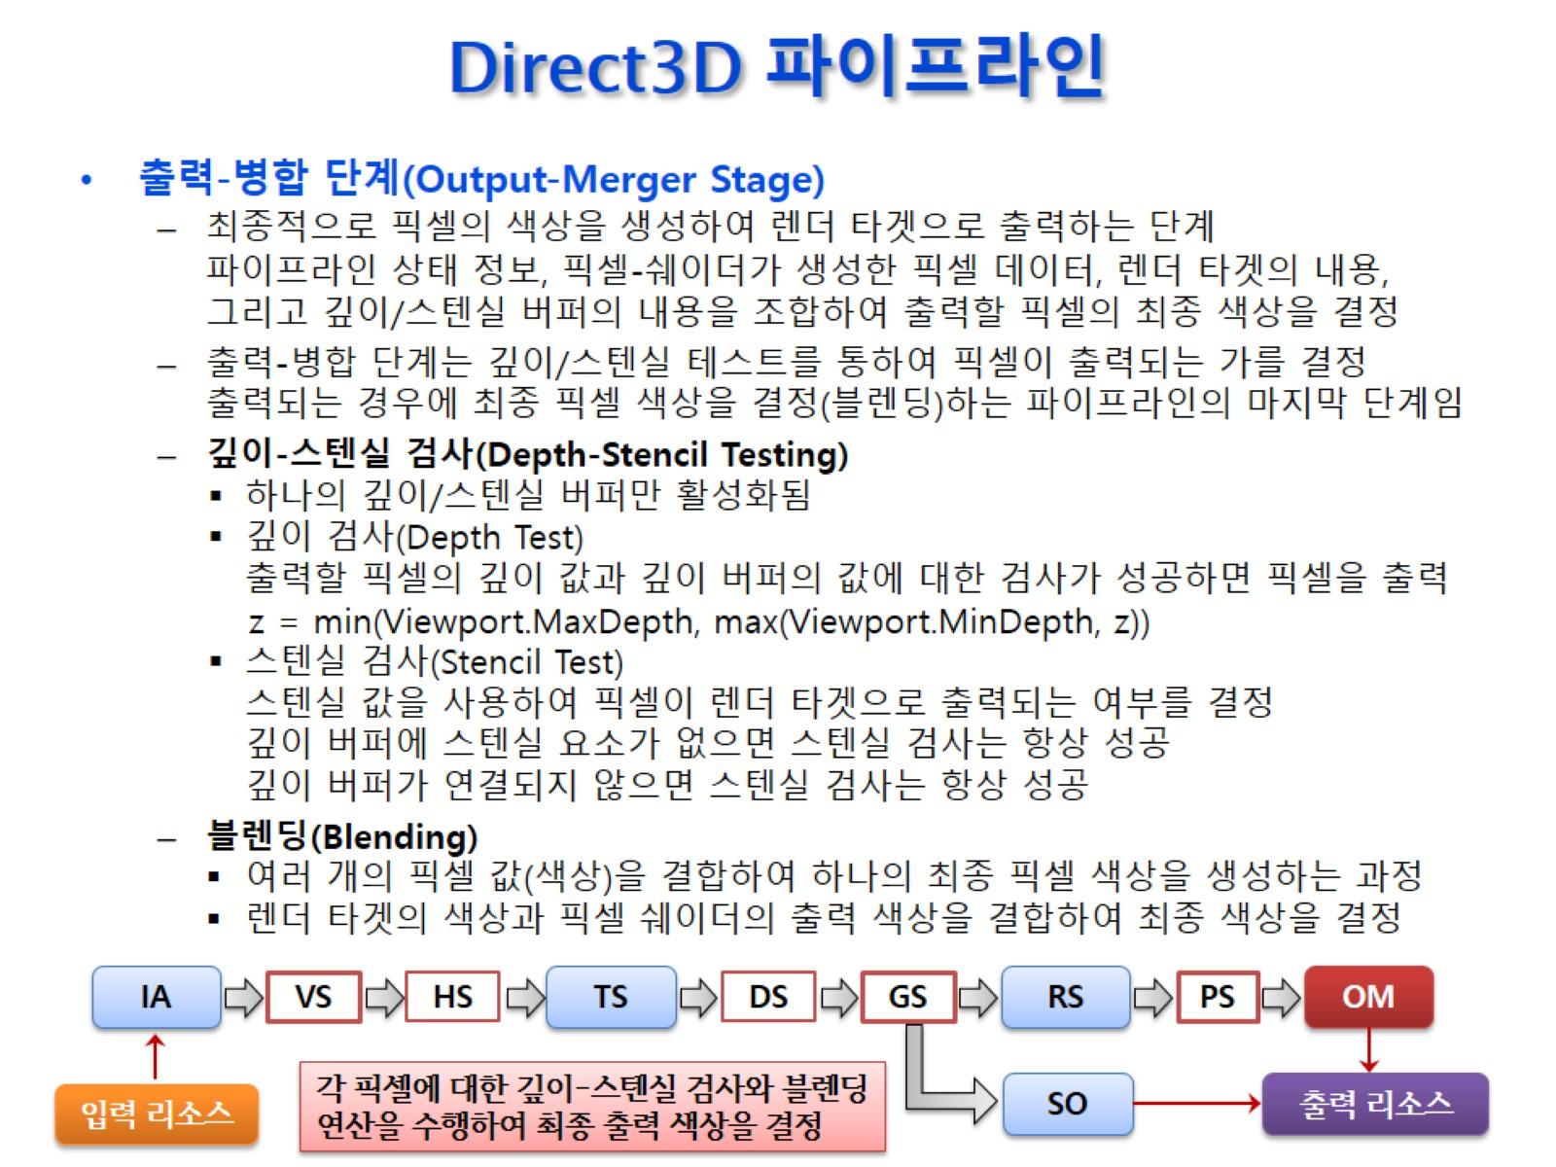
Direct3D 파이프라인

Slide 4
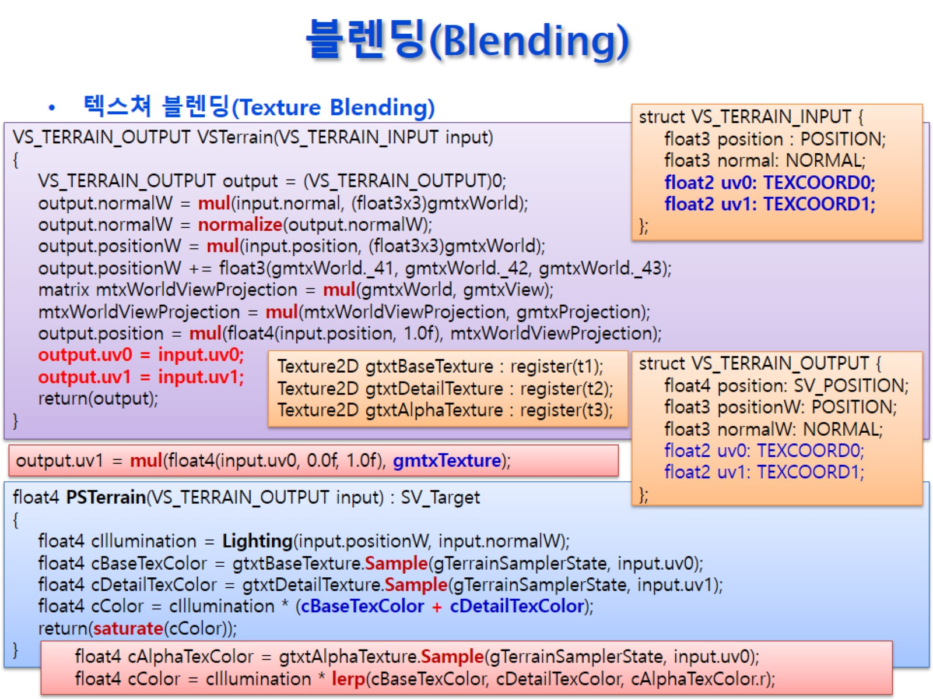
블렌딩(Blending)

Slide 5
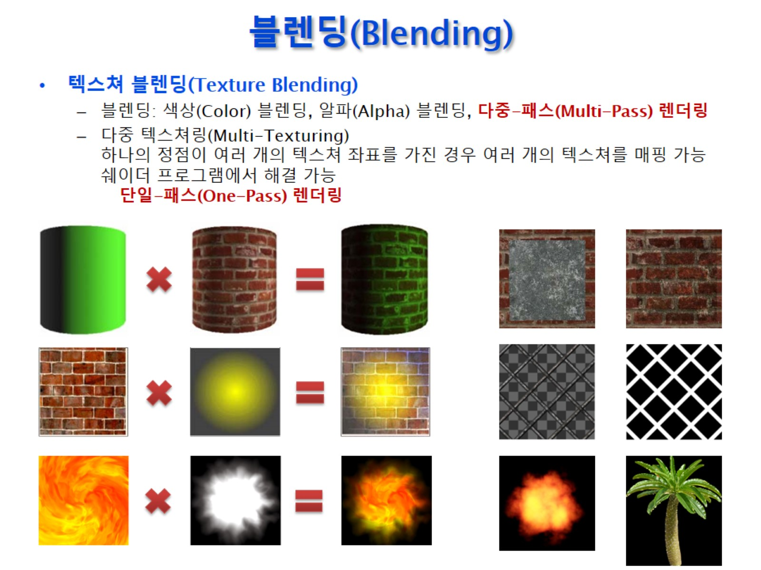
블렌딩(Blending)

Slide 6
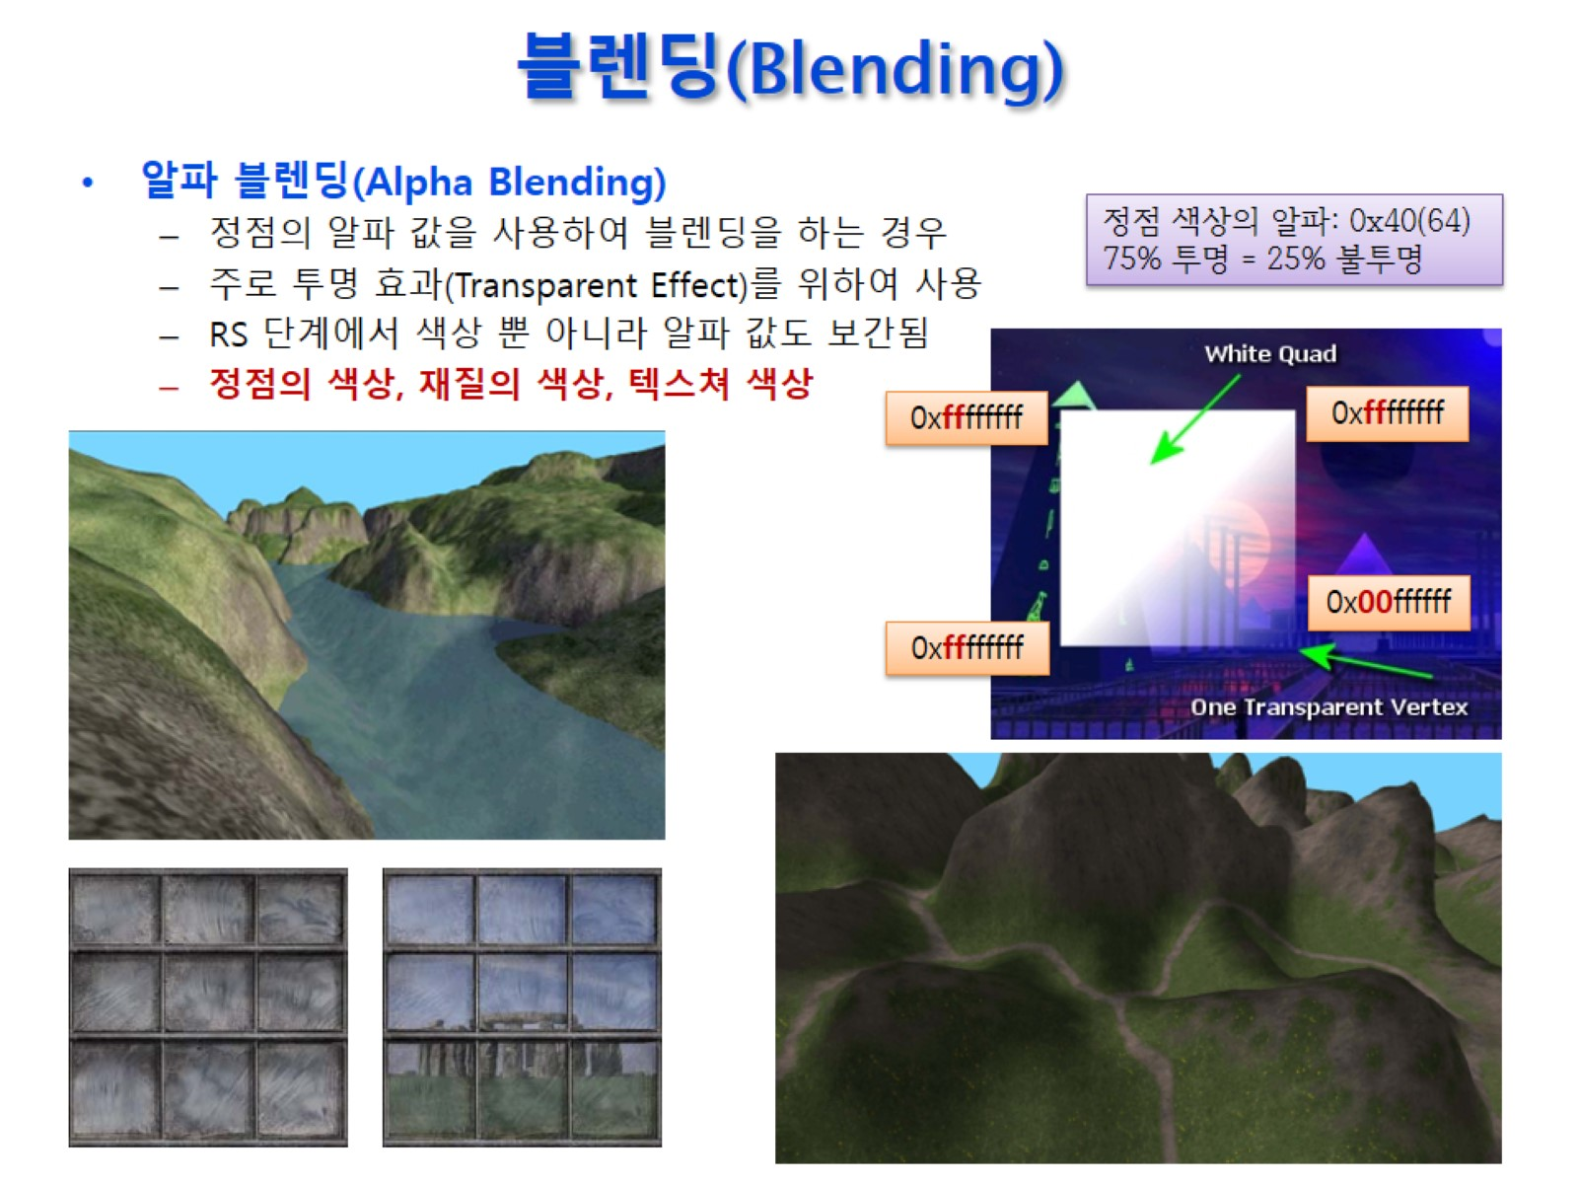
블렌딩(Blending)

Slide 7
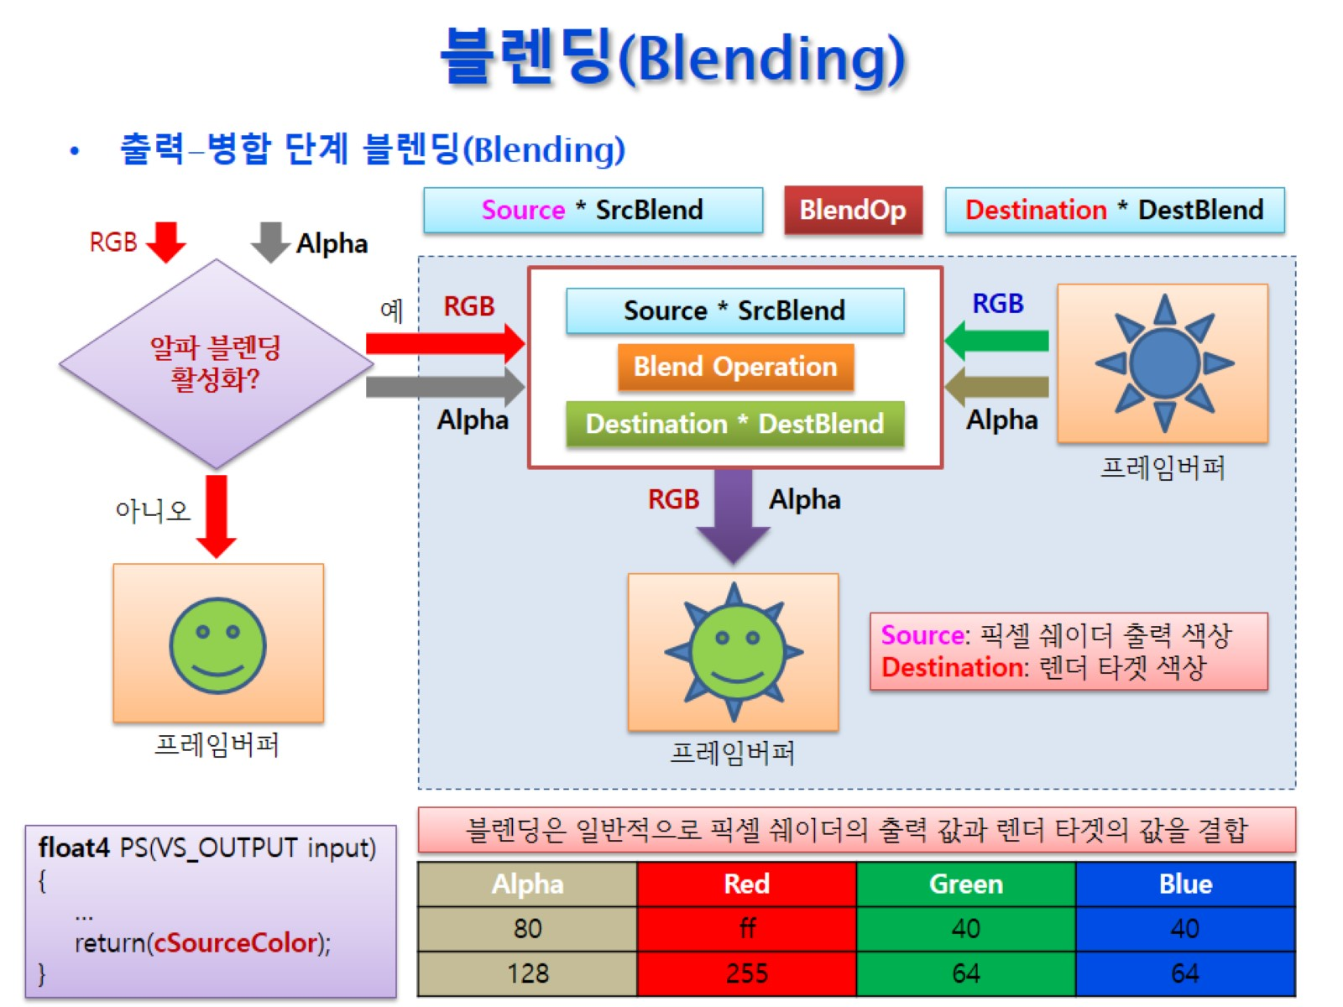
블렌딩(Blending)

Slide 8
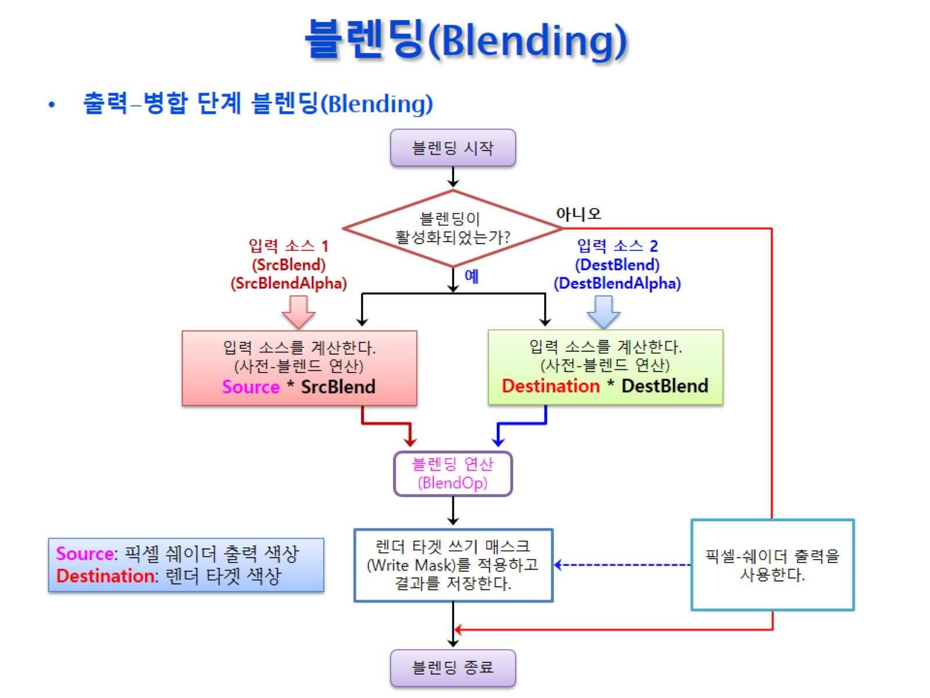
블렌딩(Blending)

Slide 9
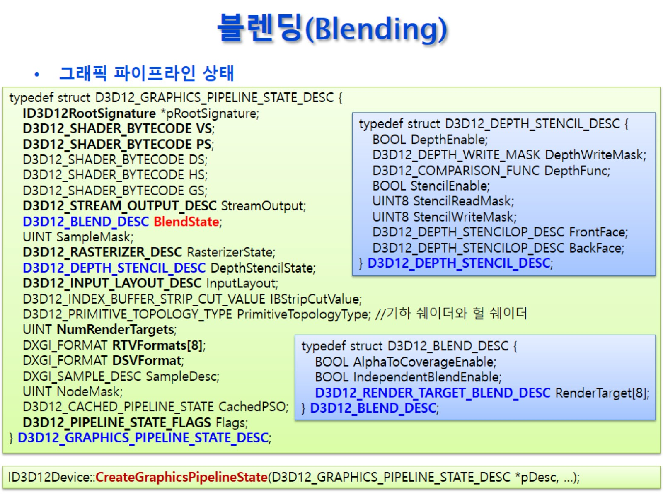
블렌딩(Blending)

Slide 10
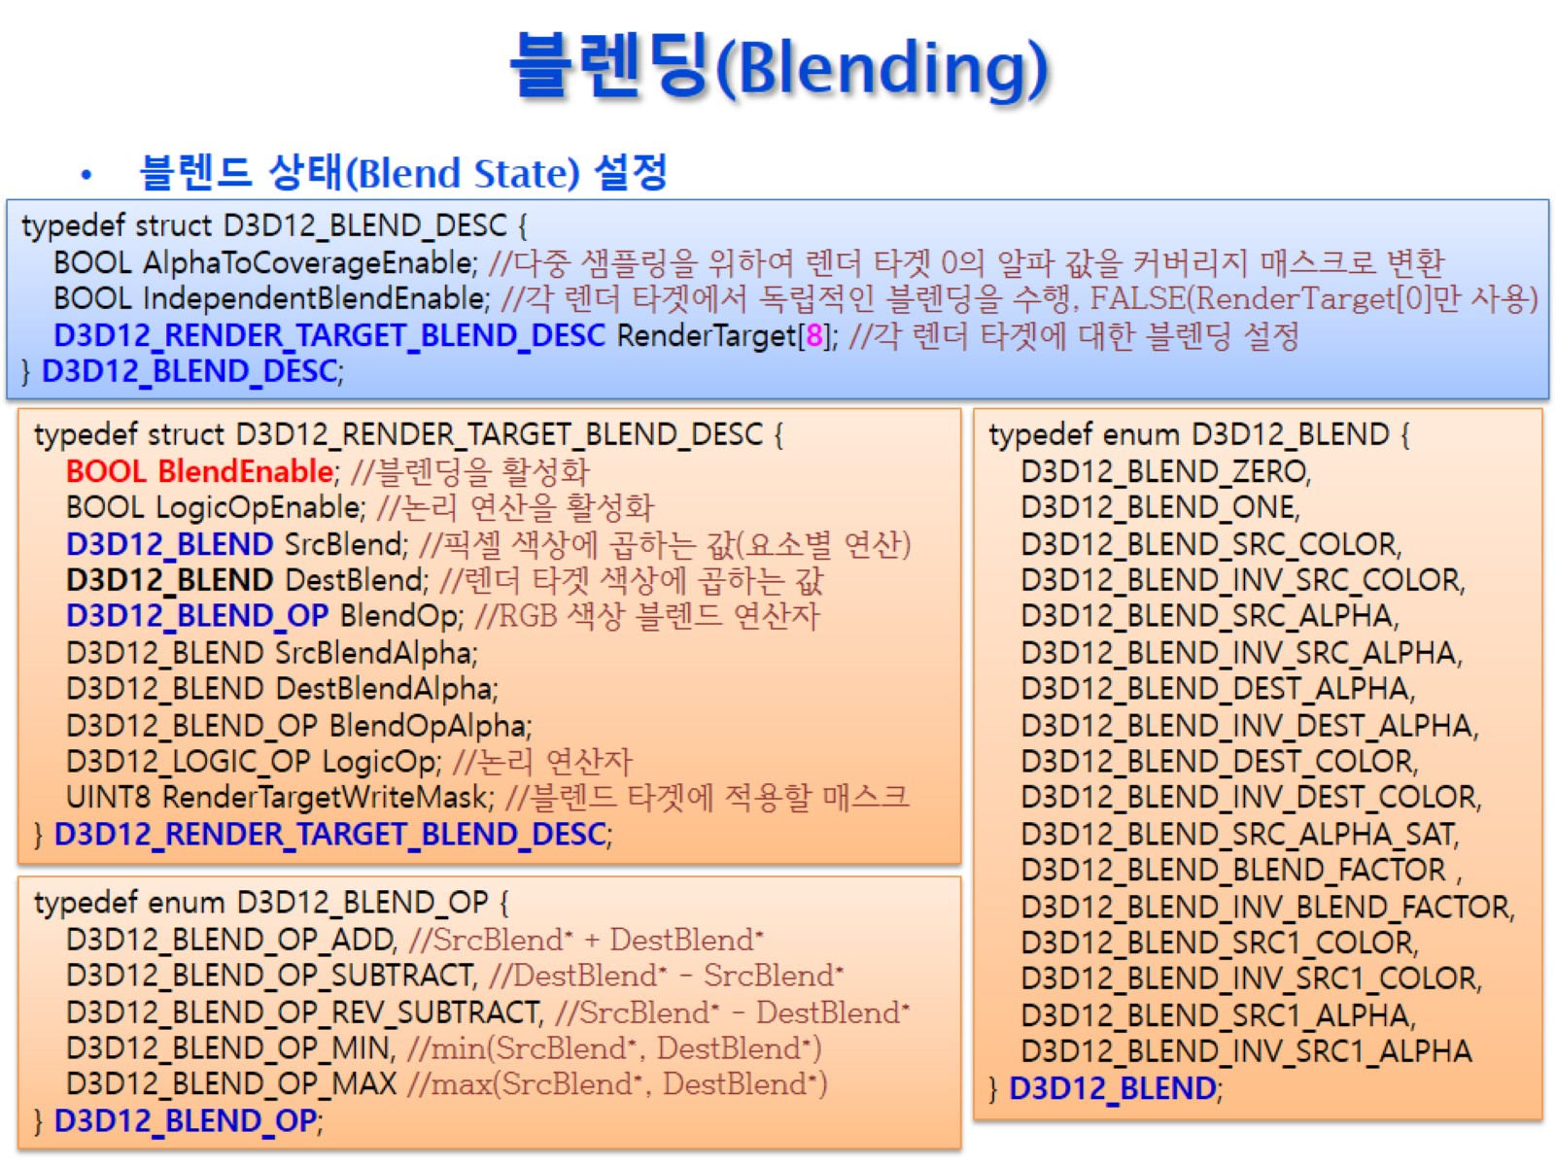
블렌딩(Blending)

Slide 11
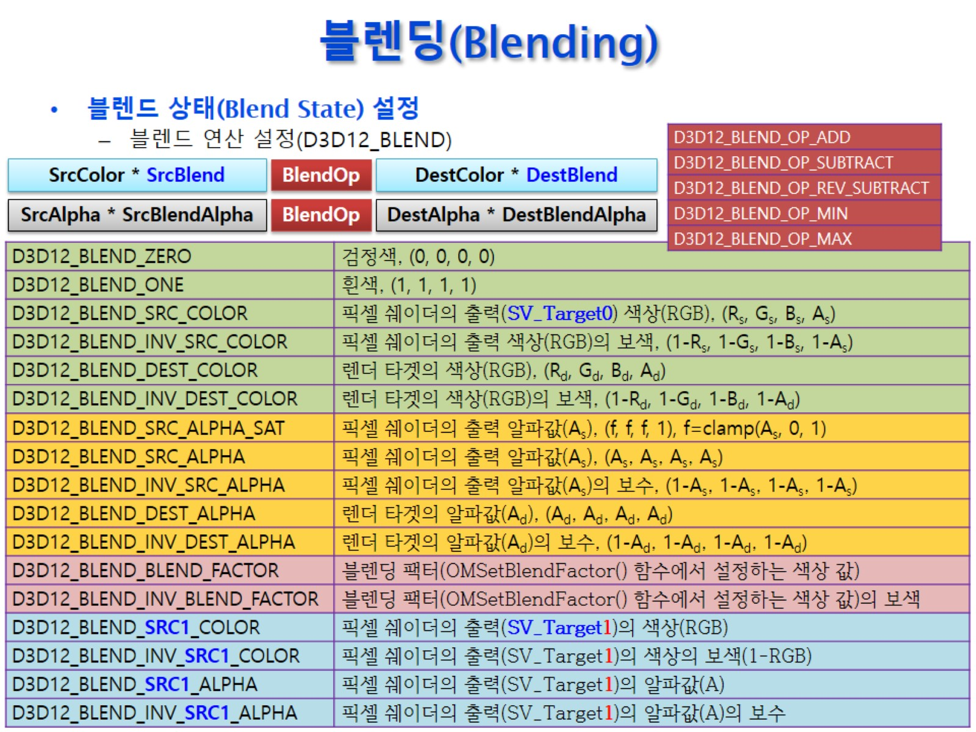
블렌딩(Blending)

Slide 12
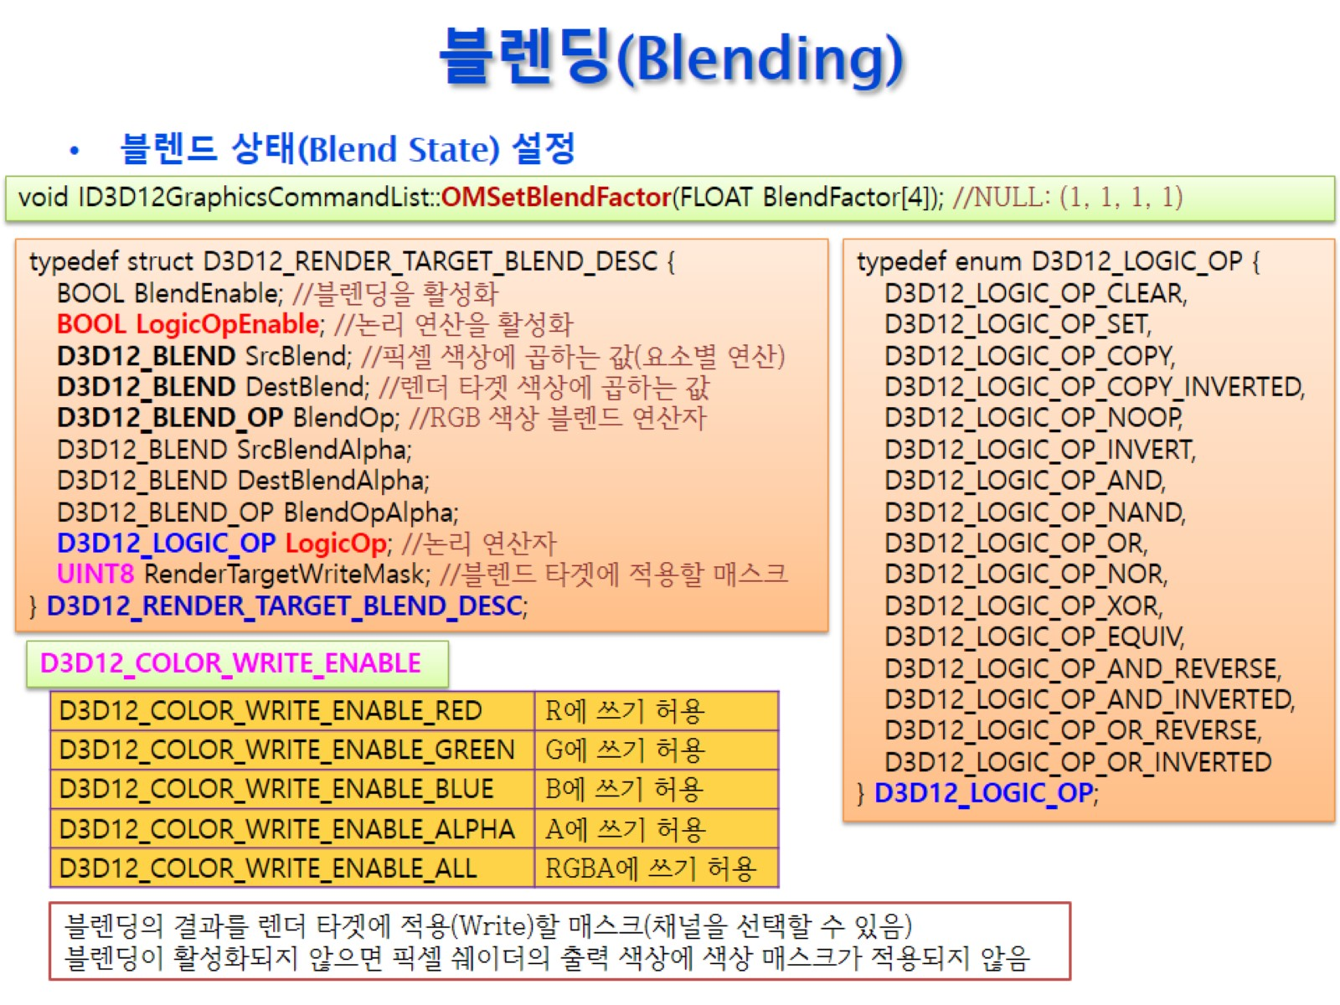
블렌딩(Blending)

Slide 13
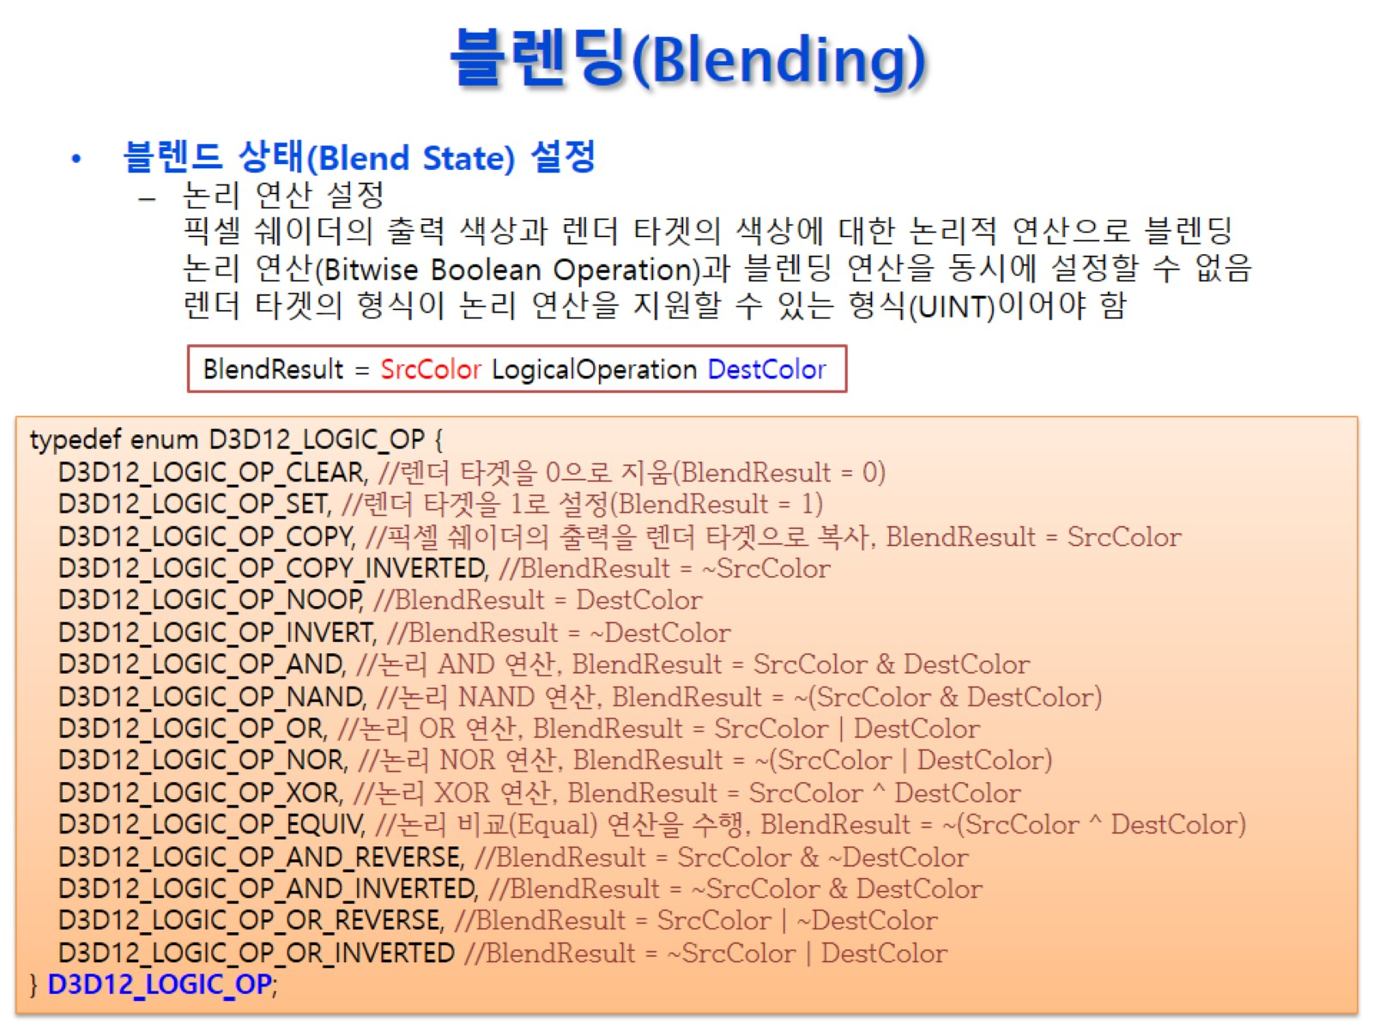
블렌딩(Blending)

Slide 14
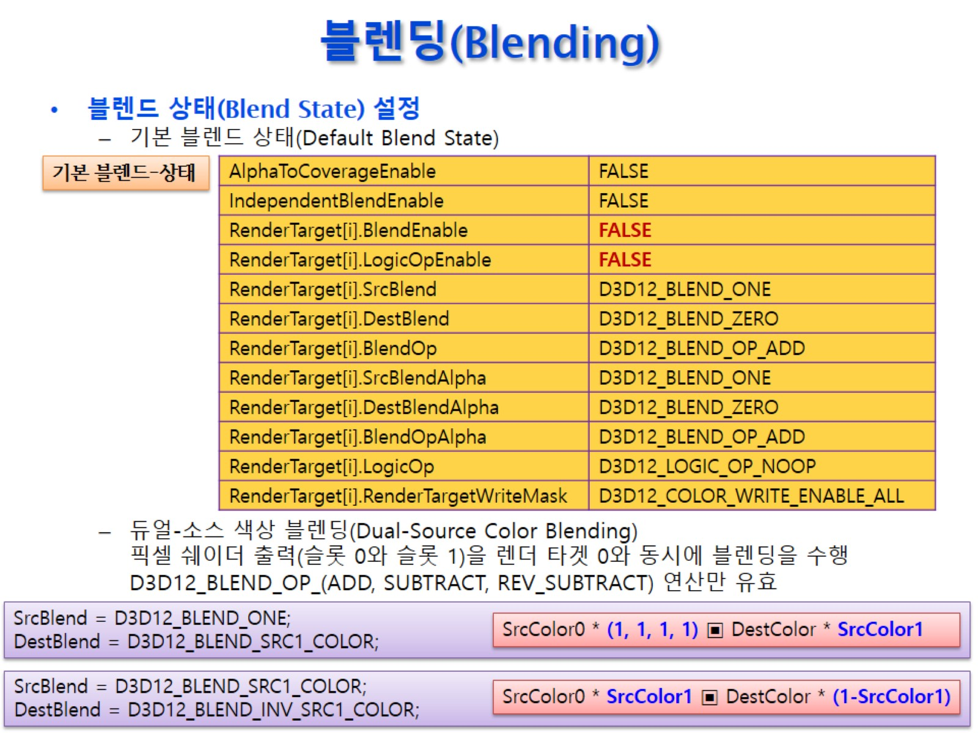
블렌딩(Blending)

Slide 15
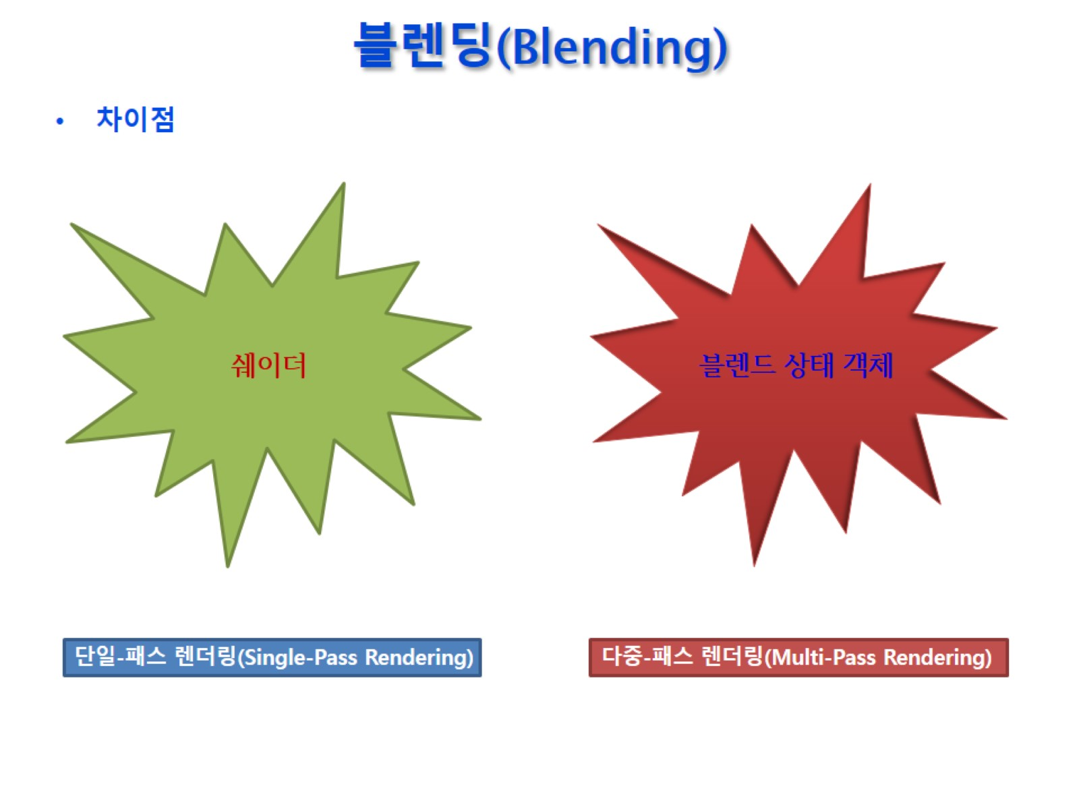
블렌딩(Blending)

Slide 16
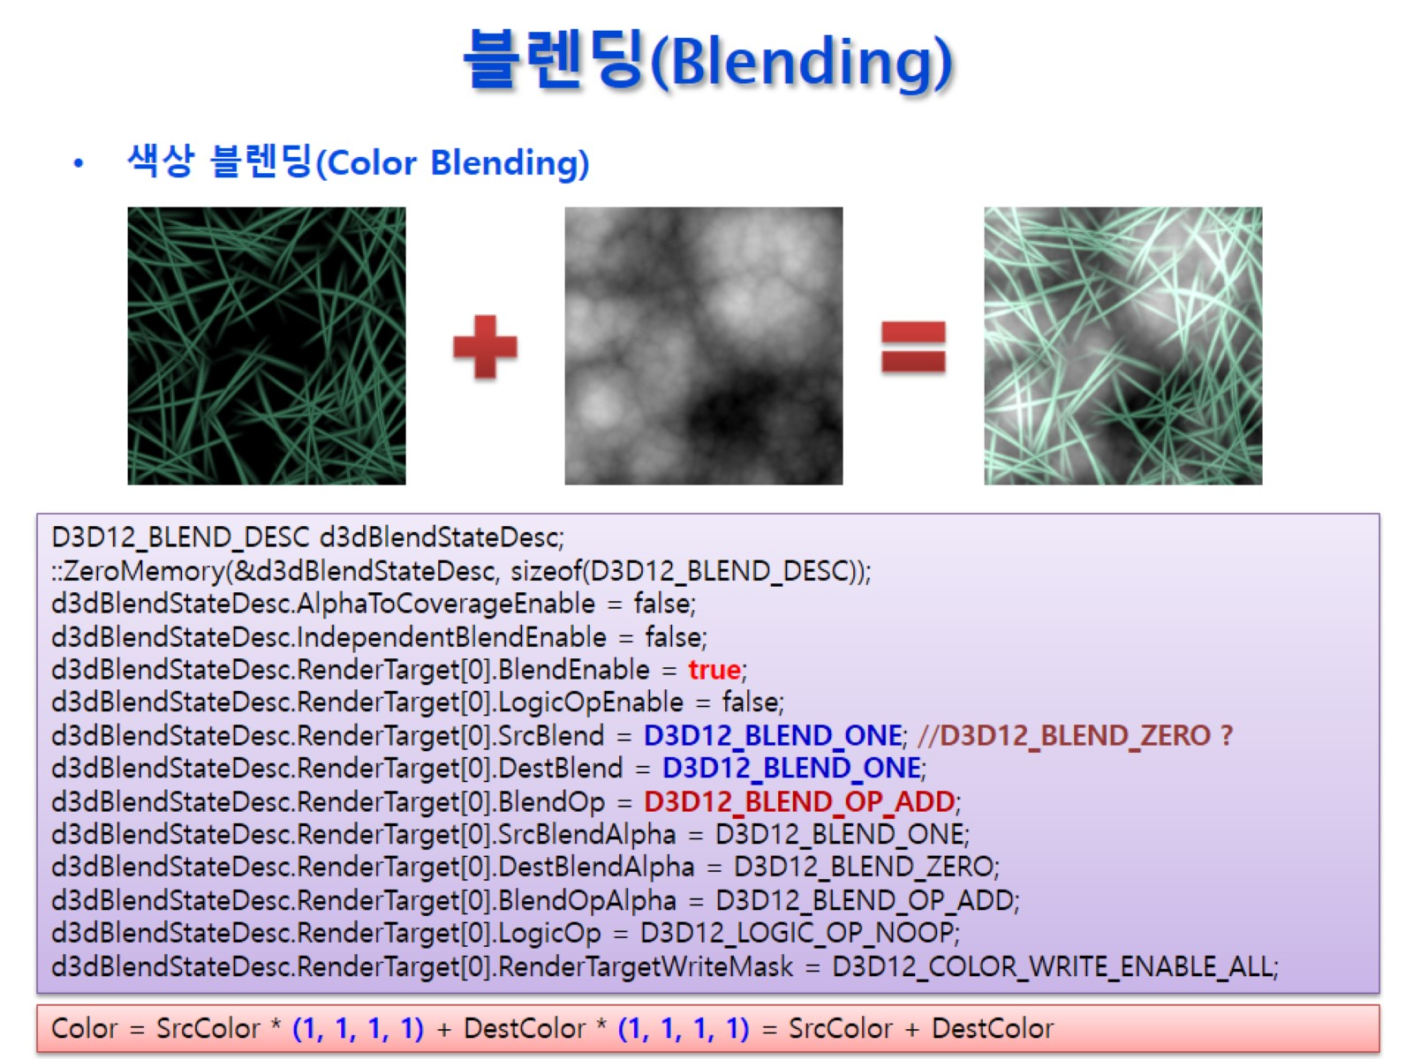
블렌딩(Blending)

Slide 17
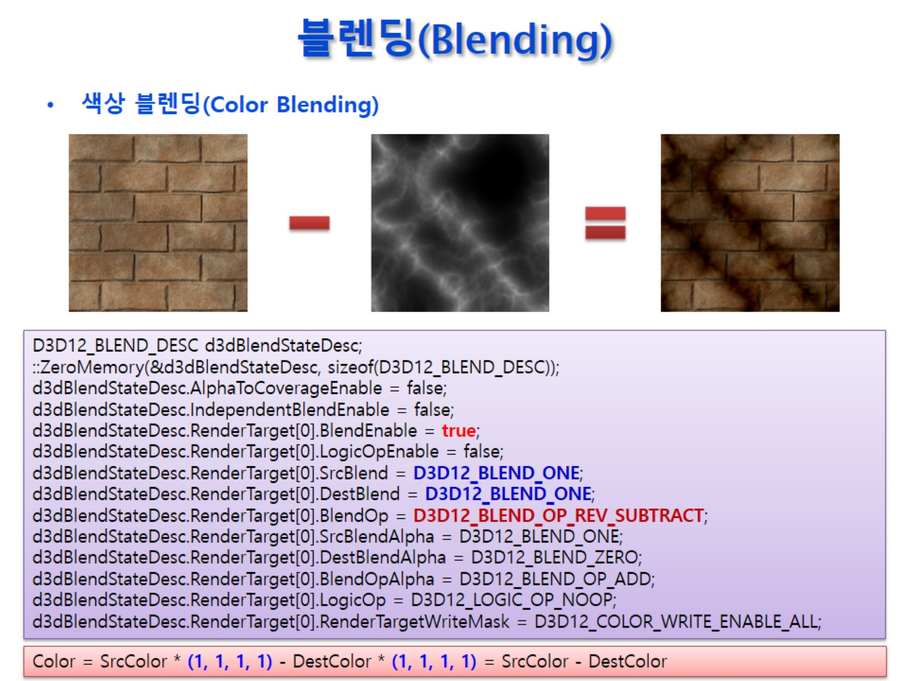
블렌딩(Blending)

Slide 18
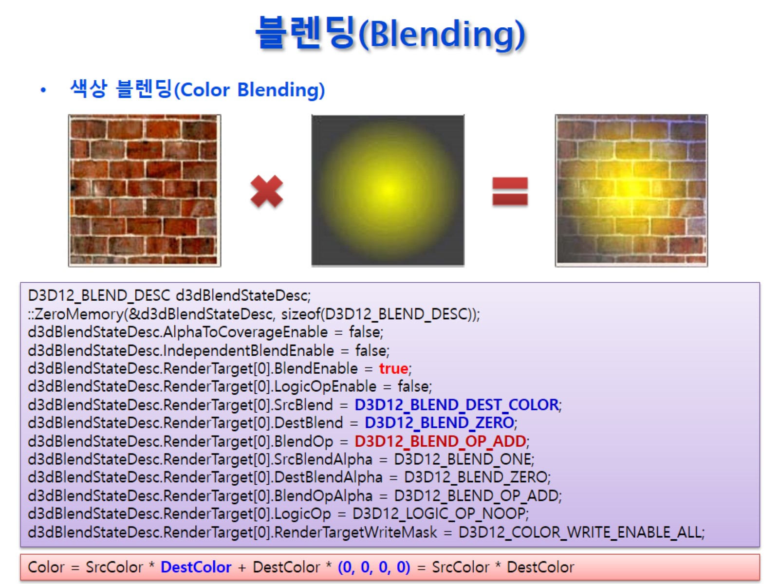
블렌딩(Blending)

Slide 19
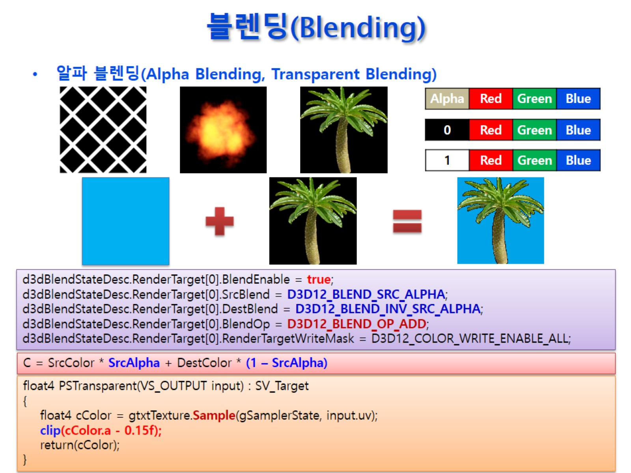
블렌딩(Blending)

Slide 20
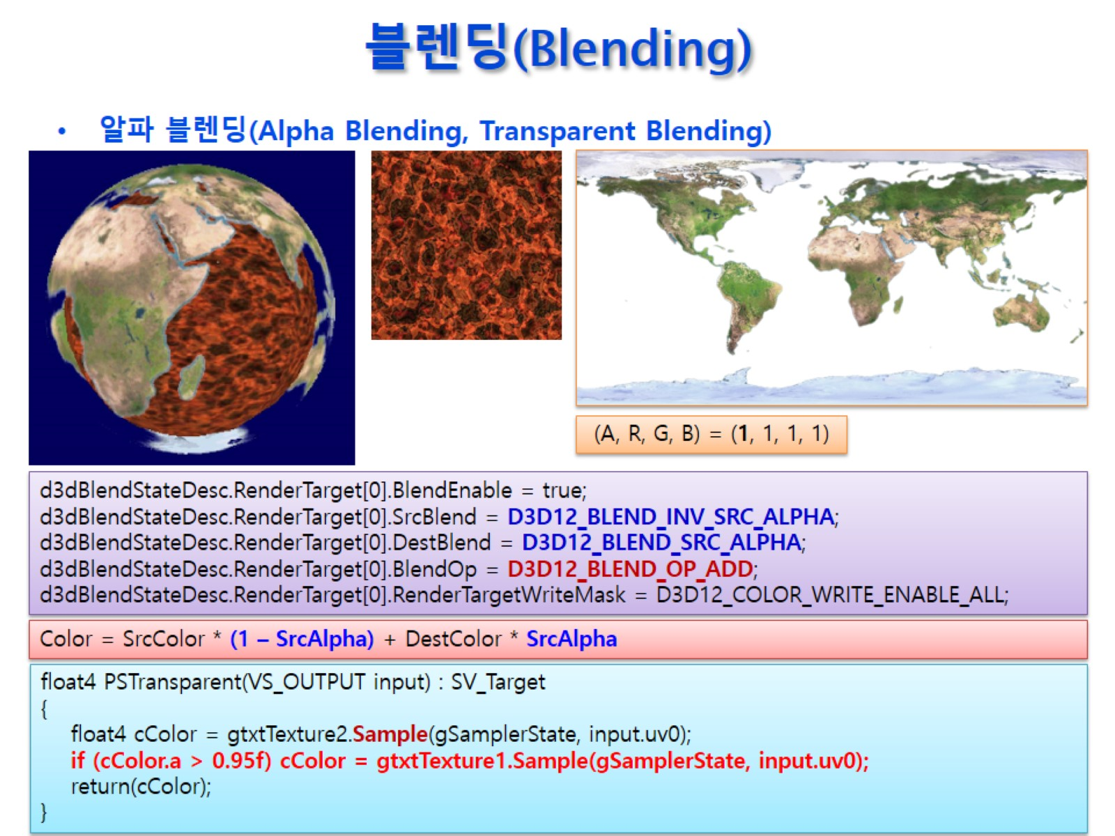
블렌딩(Blending)

Slide 21
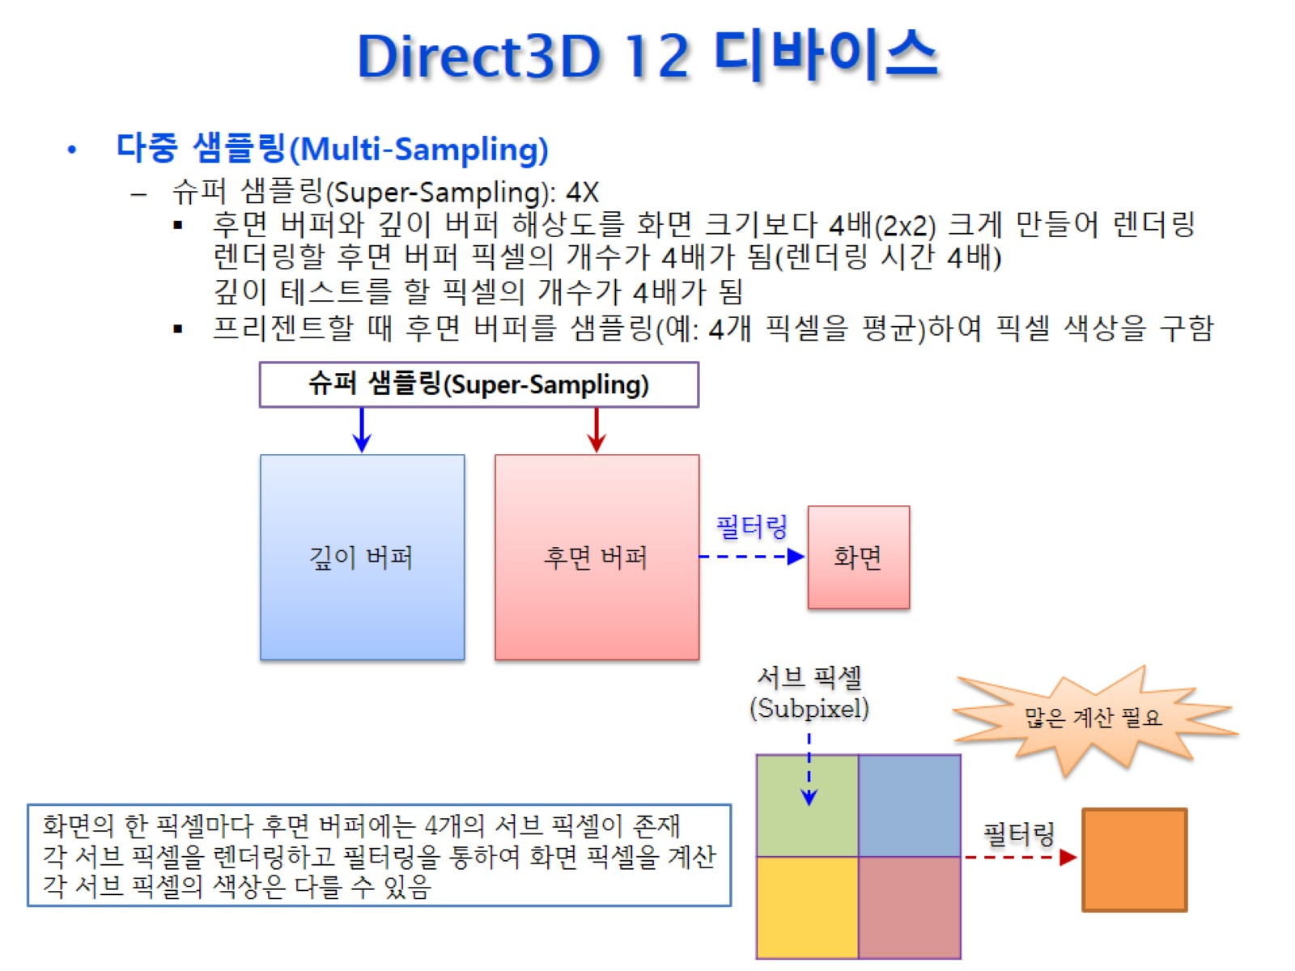
Direct3D 12 디바이스

Slide 22
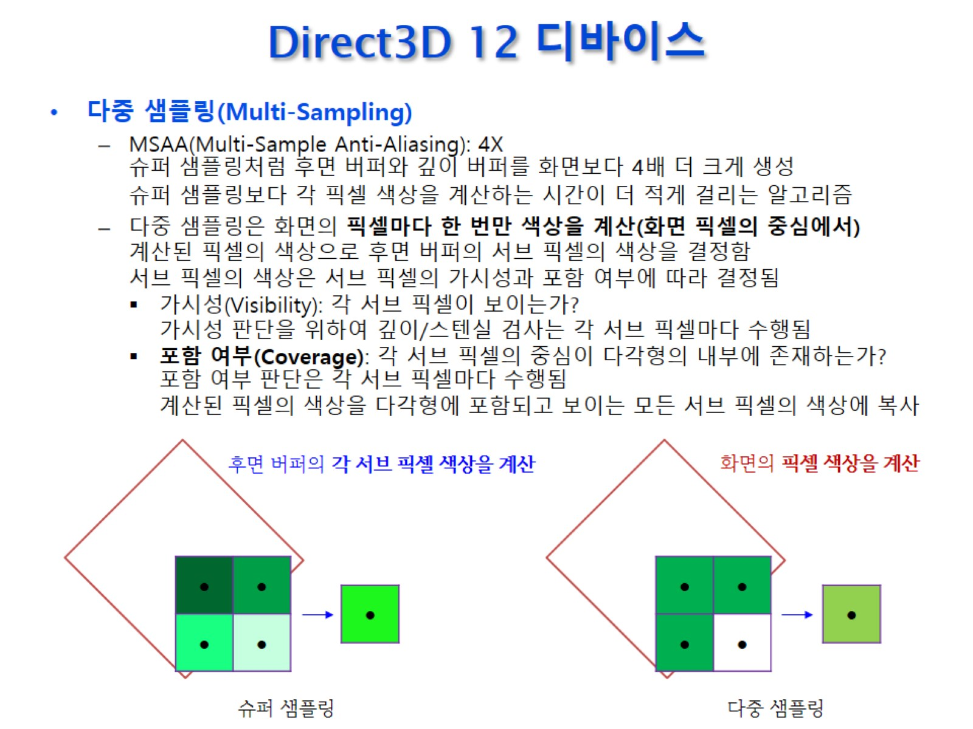
Direct3D 12 디바이스

Slide 23
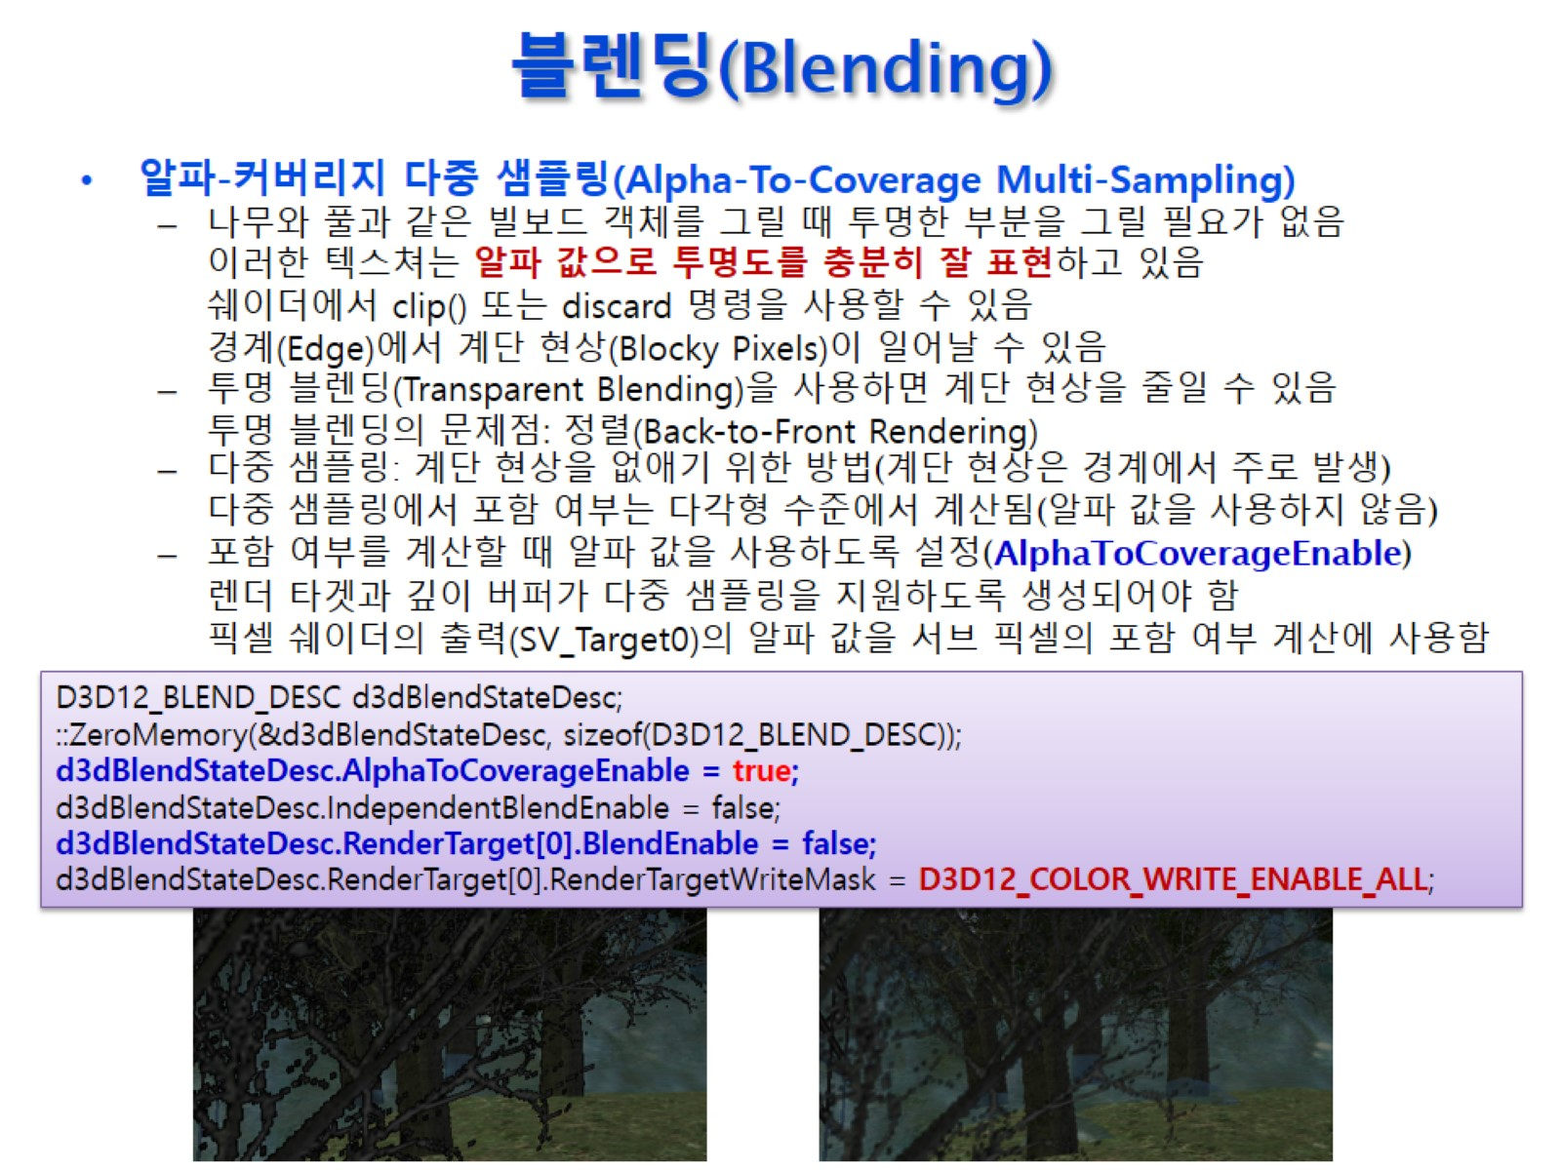
블렌딩(Blending)

Slide 24
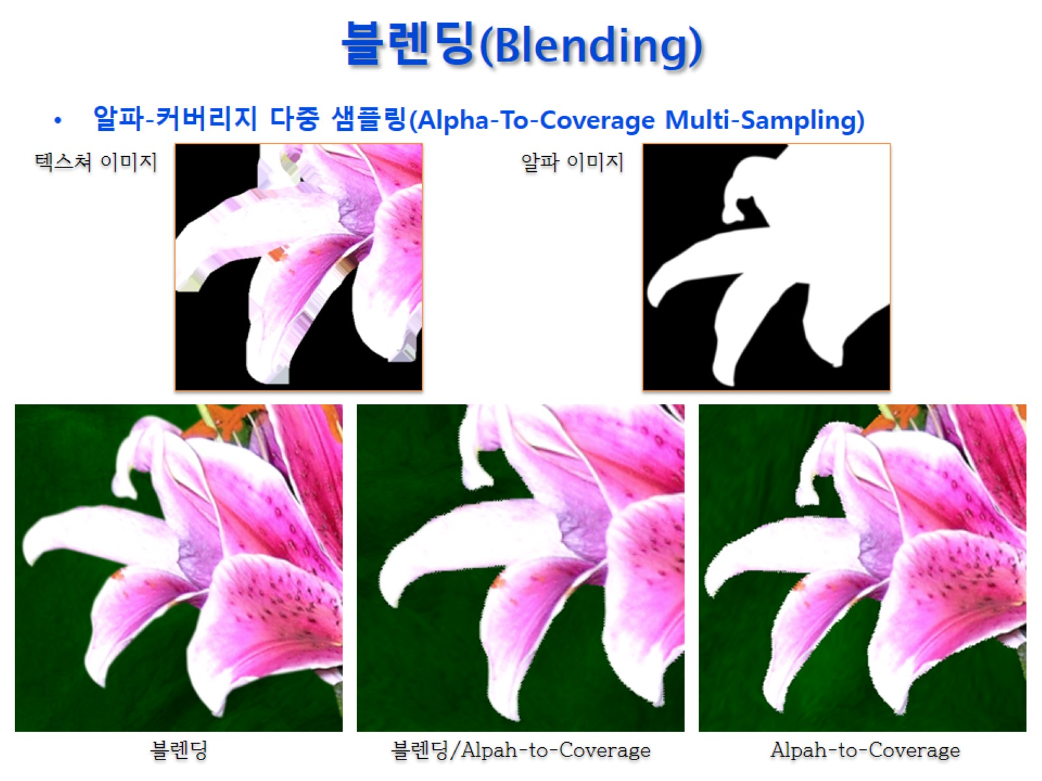
블렌딩(Blending)

Slide 25
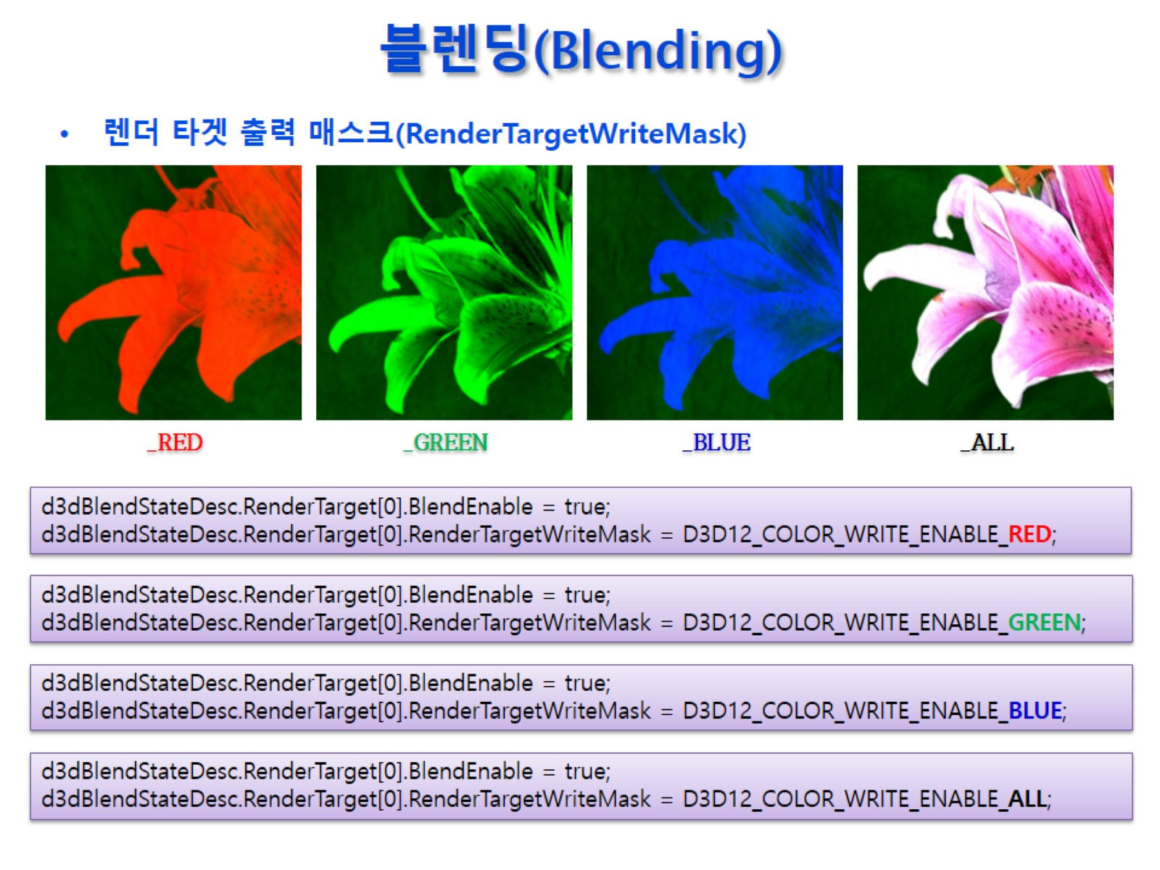
블렌딩(Blending)

Slide 26
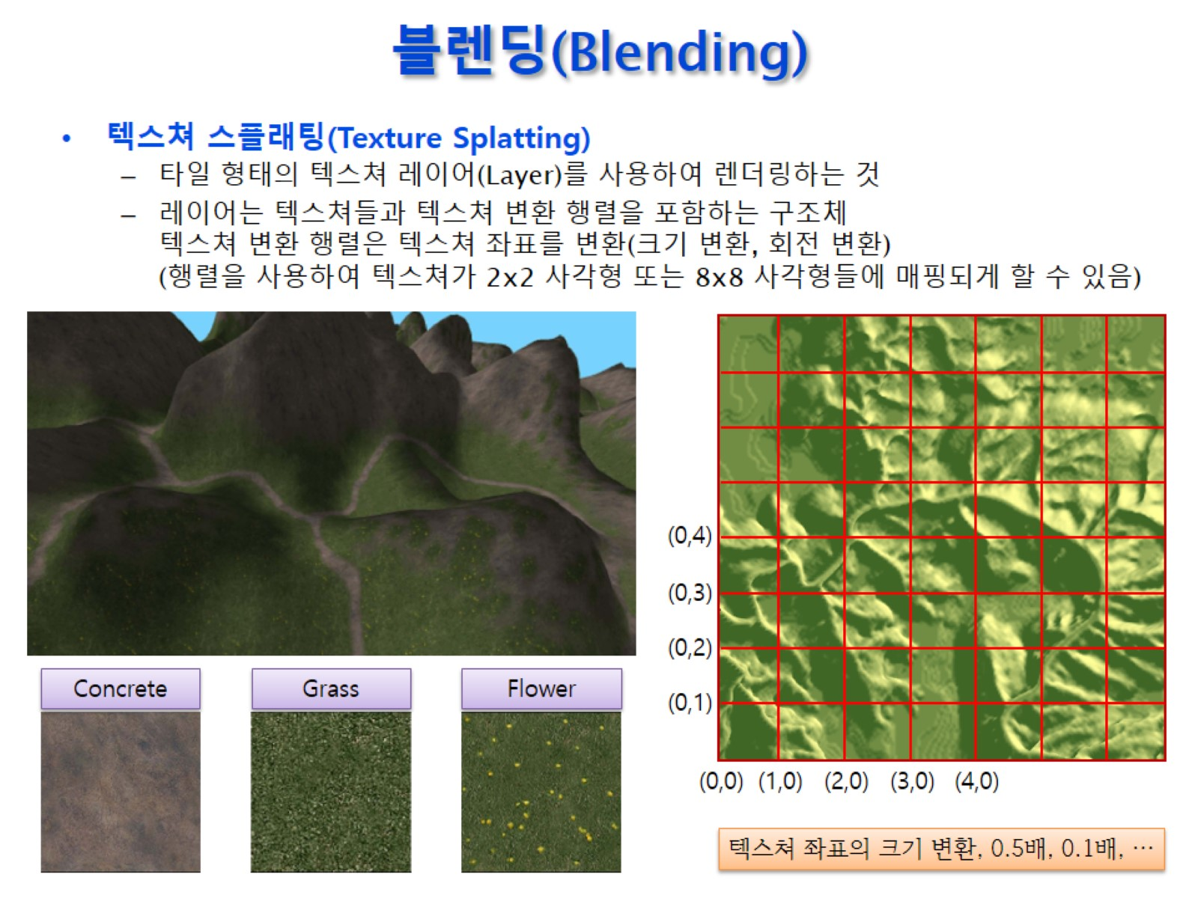
블렌딩(Blending)

Slide 27
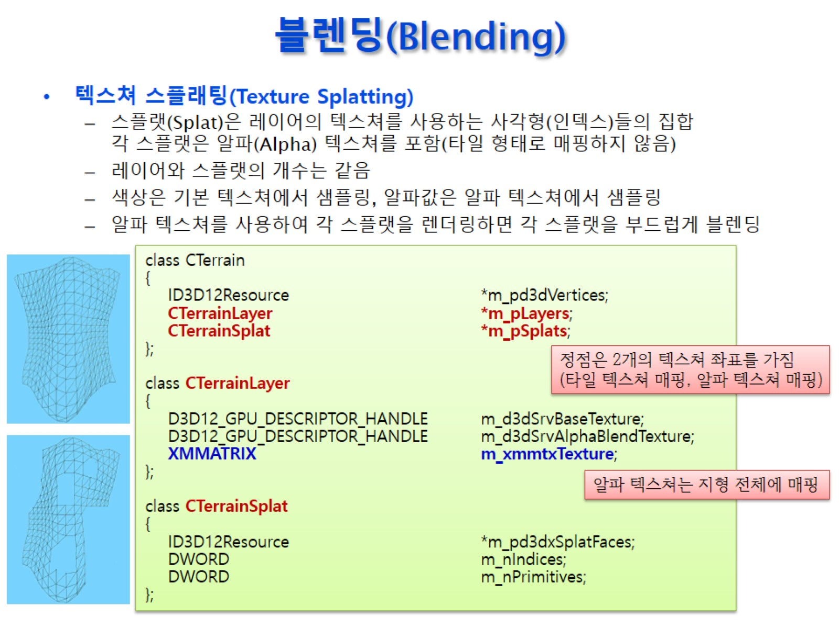
블렌딩(Blending)

Slide 28
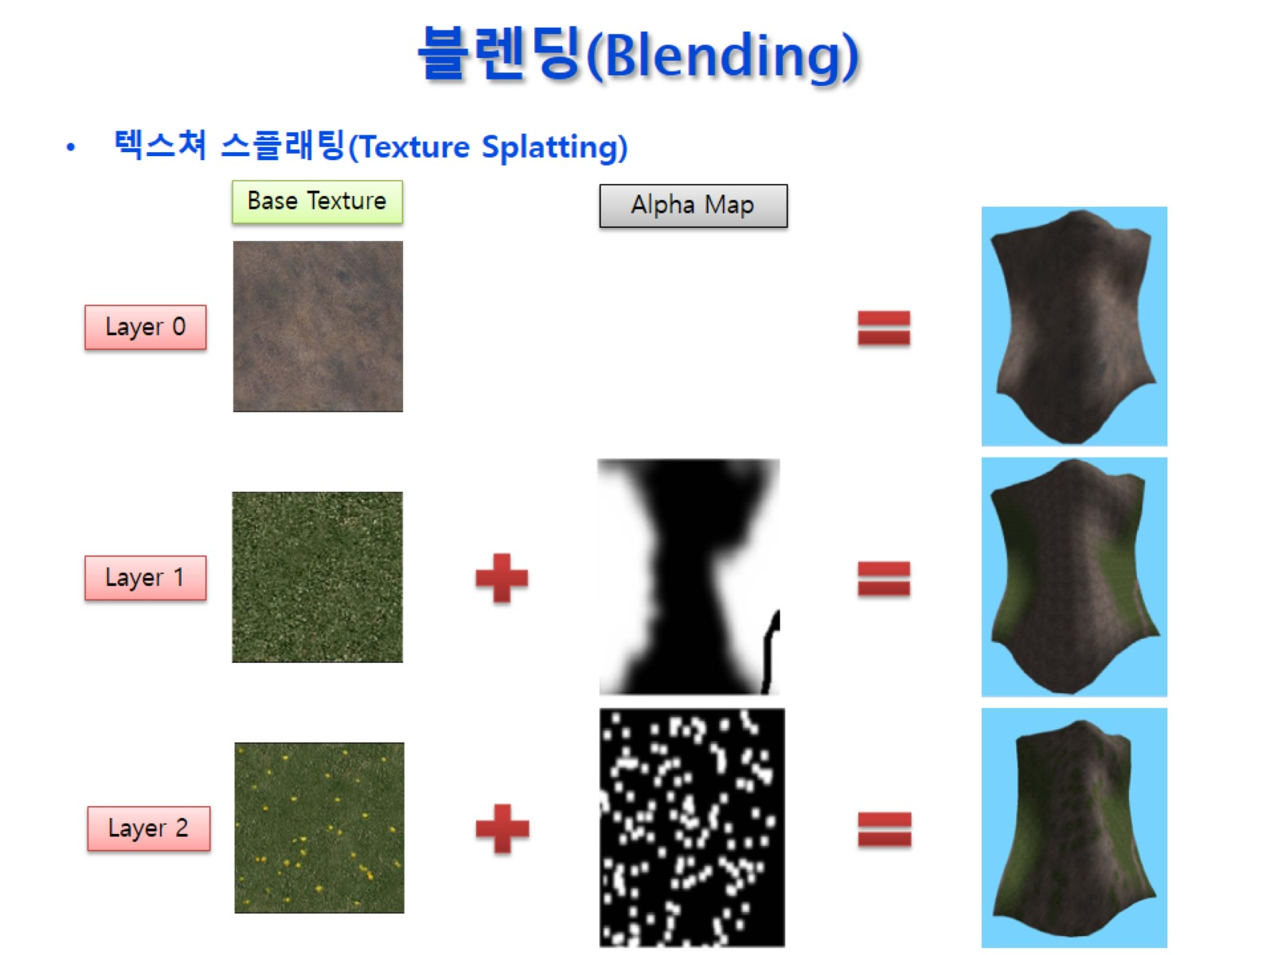
블렌딩(Blending)

Slide 29
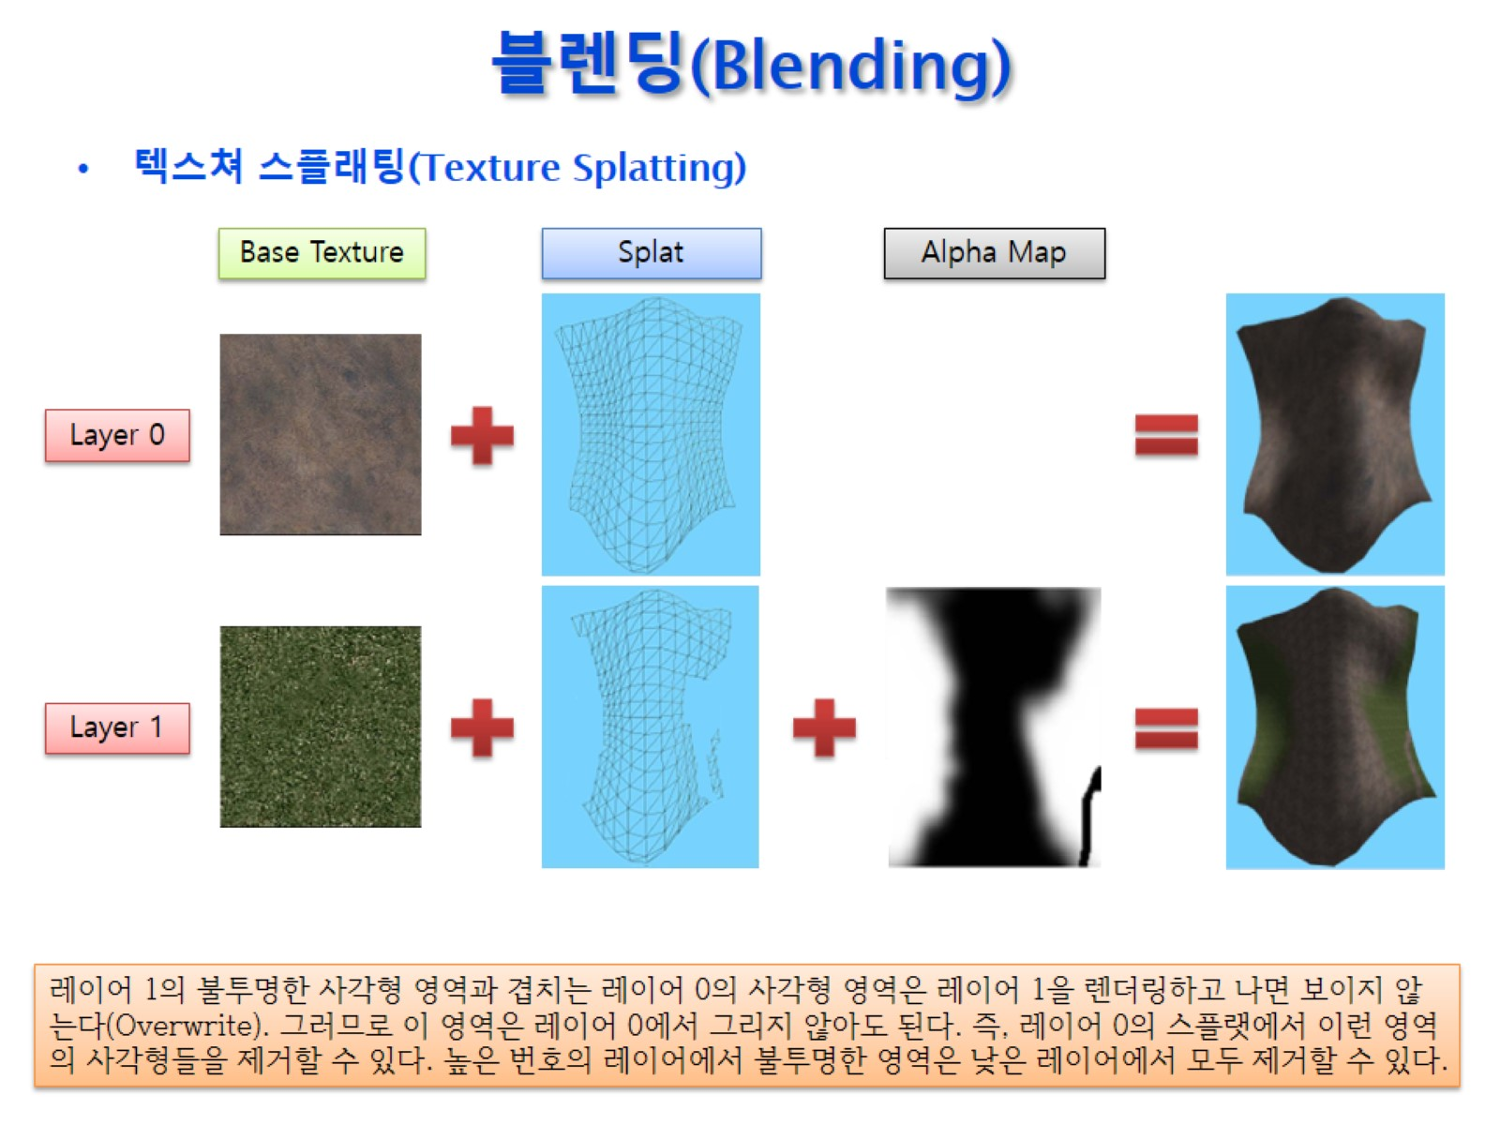
블렌딩(Blending)

Slide 30
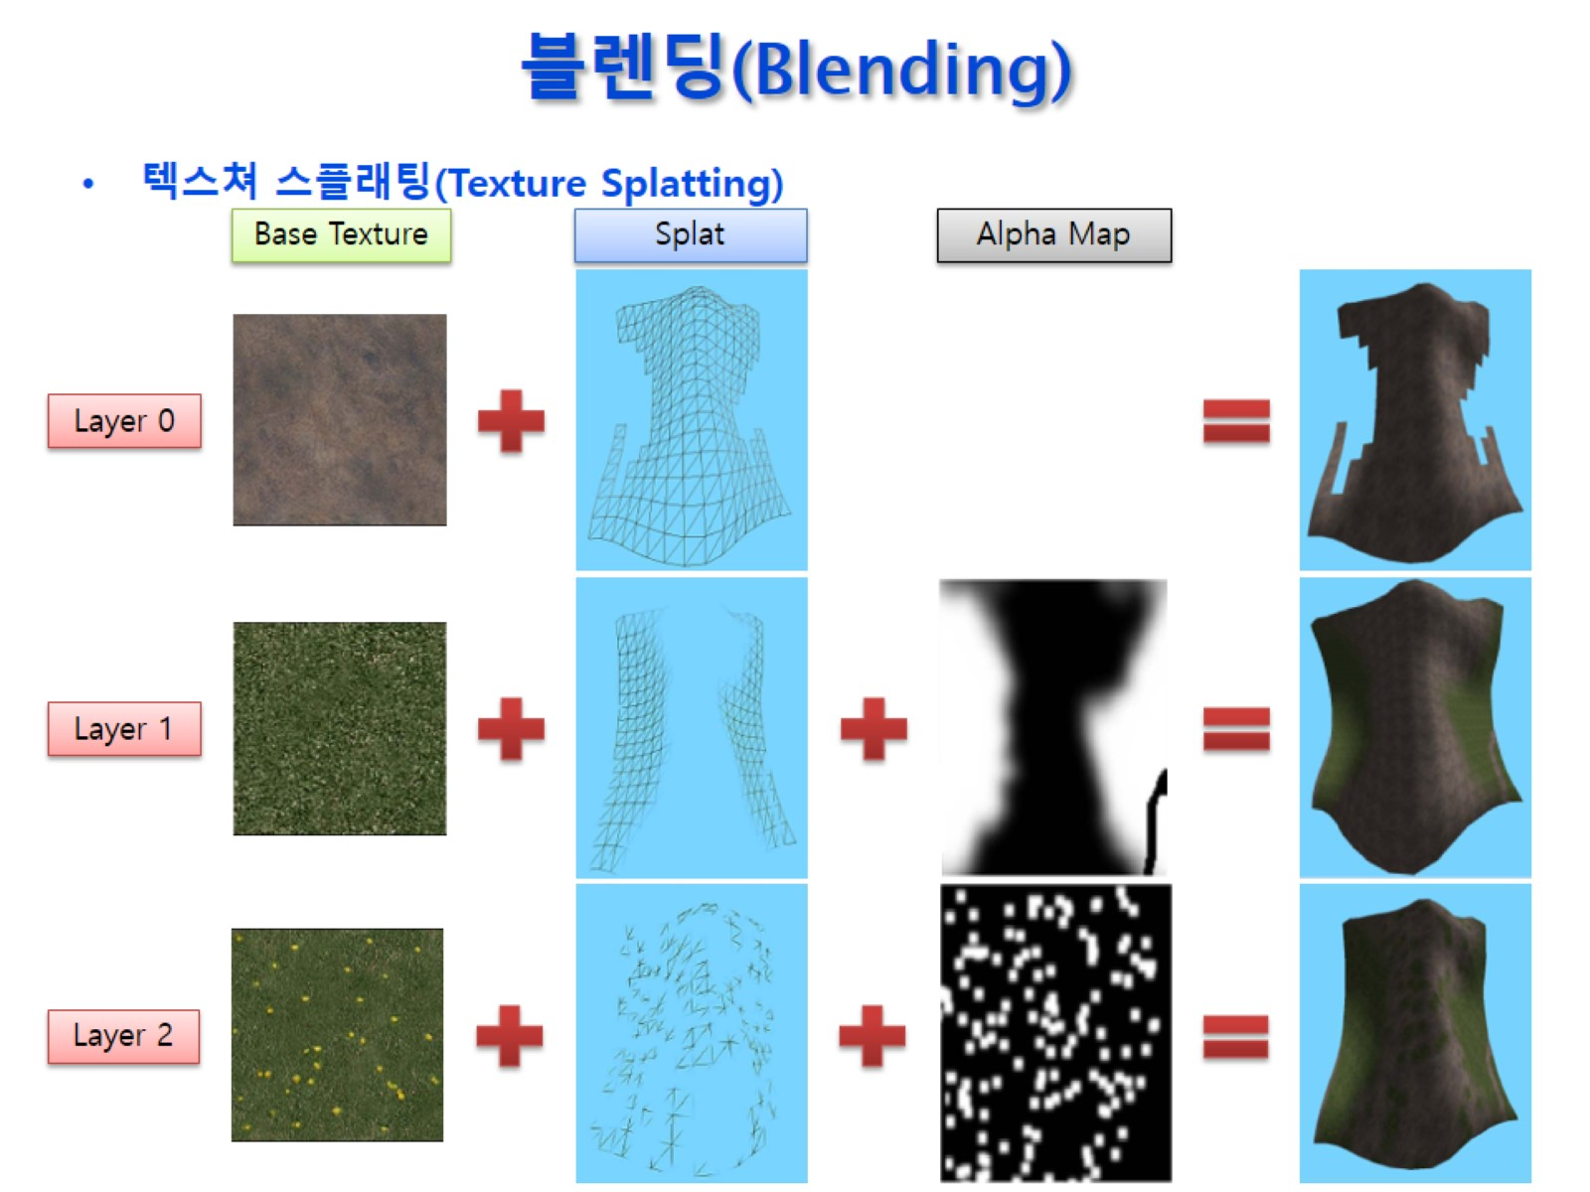
블렌딩(Blending)

Slide 31
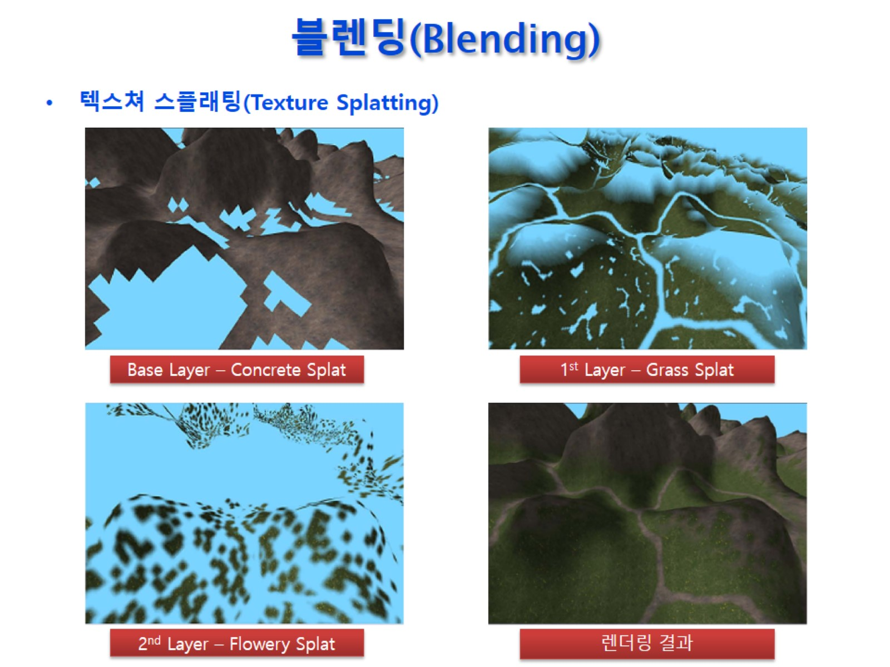
블렌딩(Blending)

Slide 32
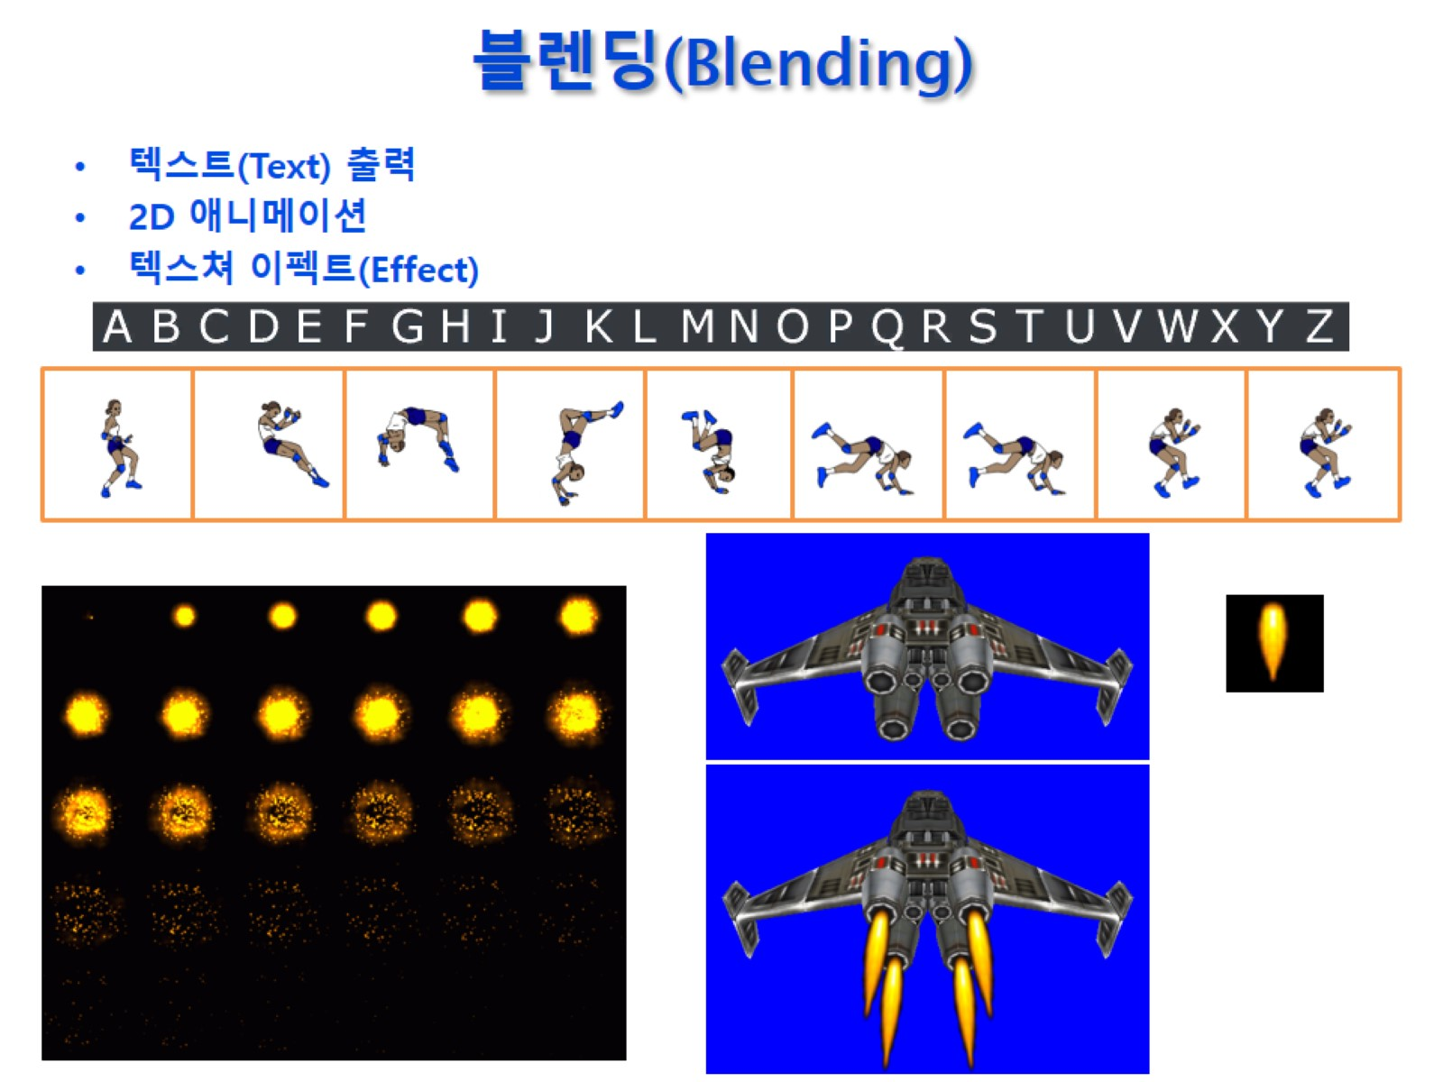
블렌딩(Blending)

Slide 33
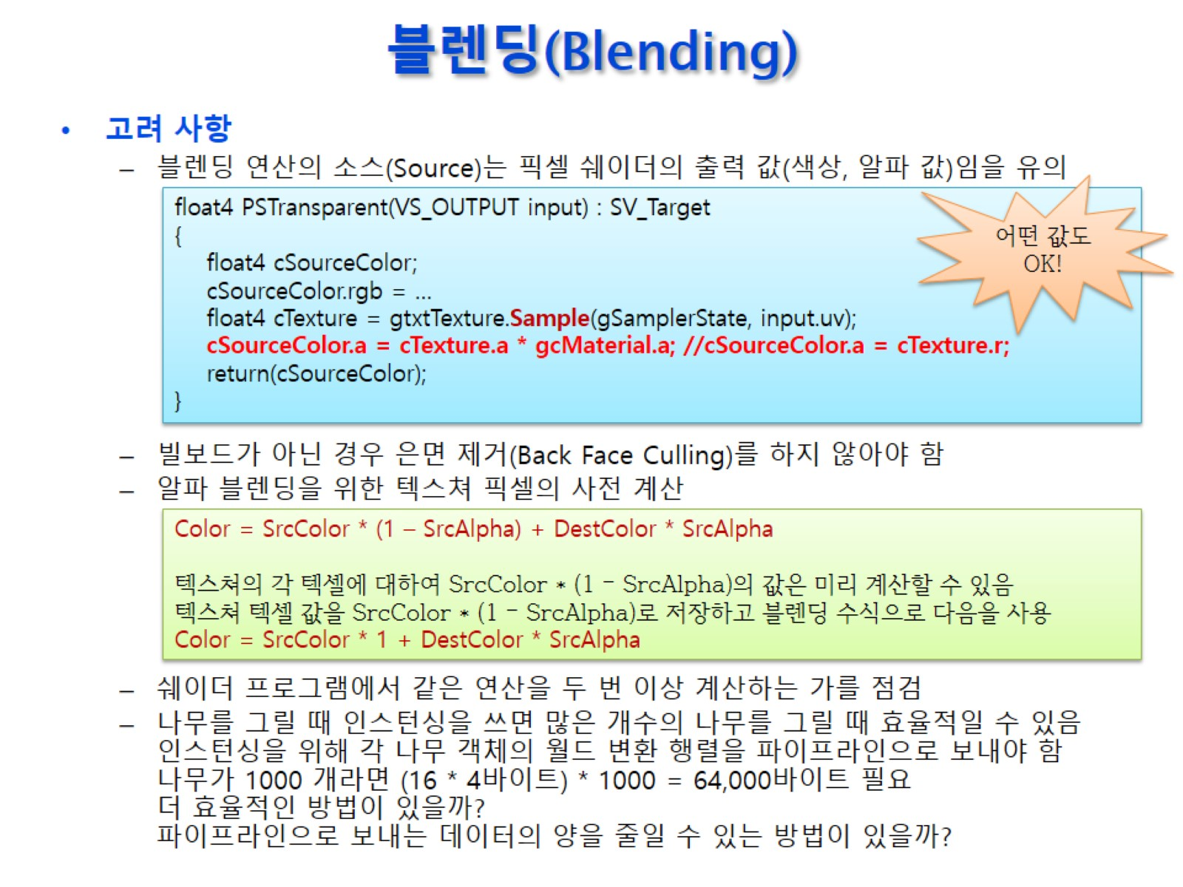
블렌딩(Blending)

Slide 34
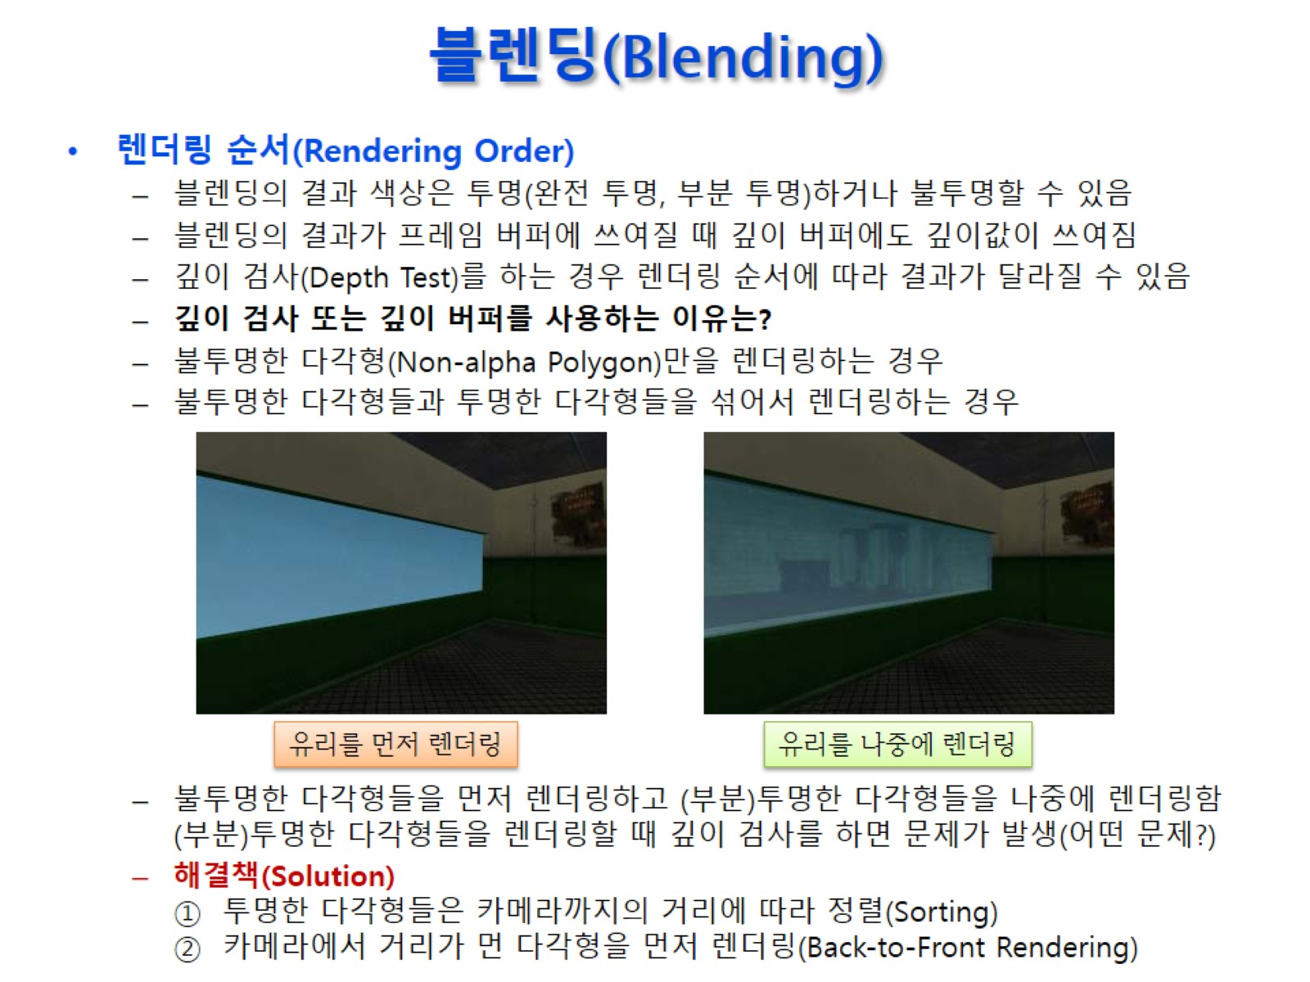
블렌딩(Blending)

Slide 35
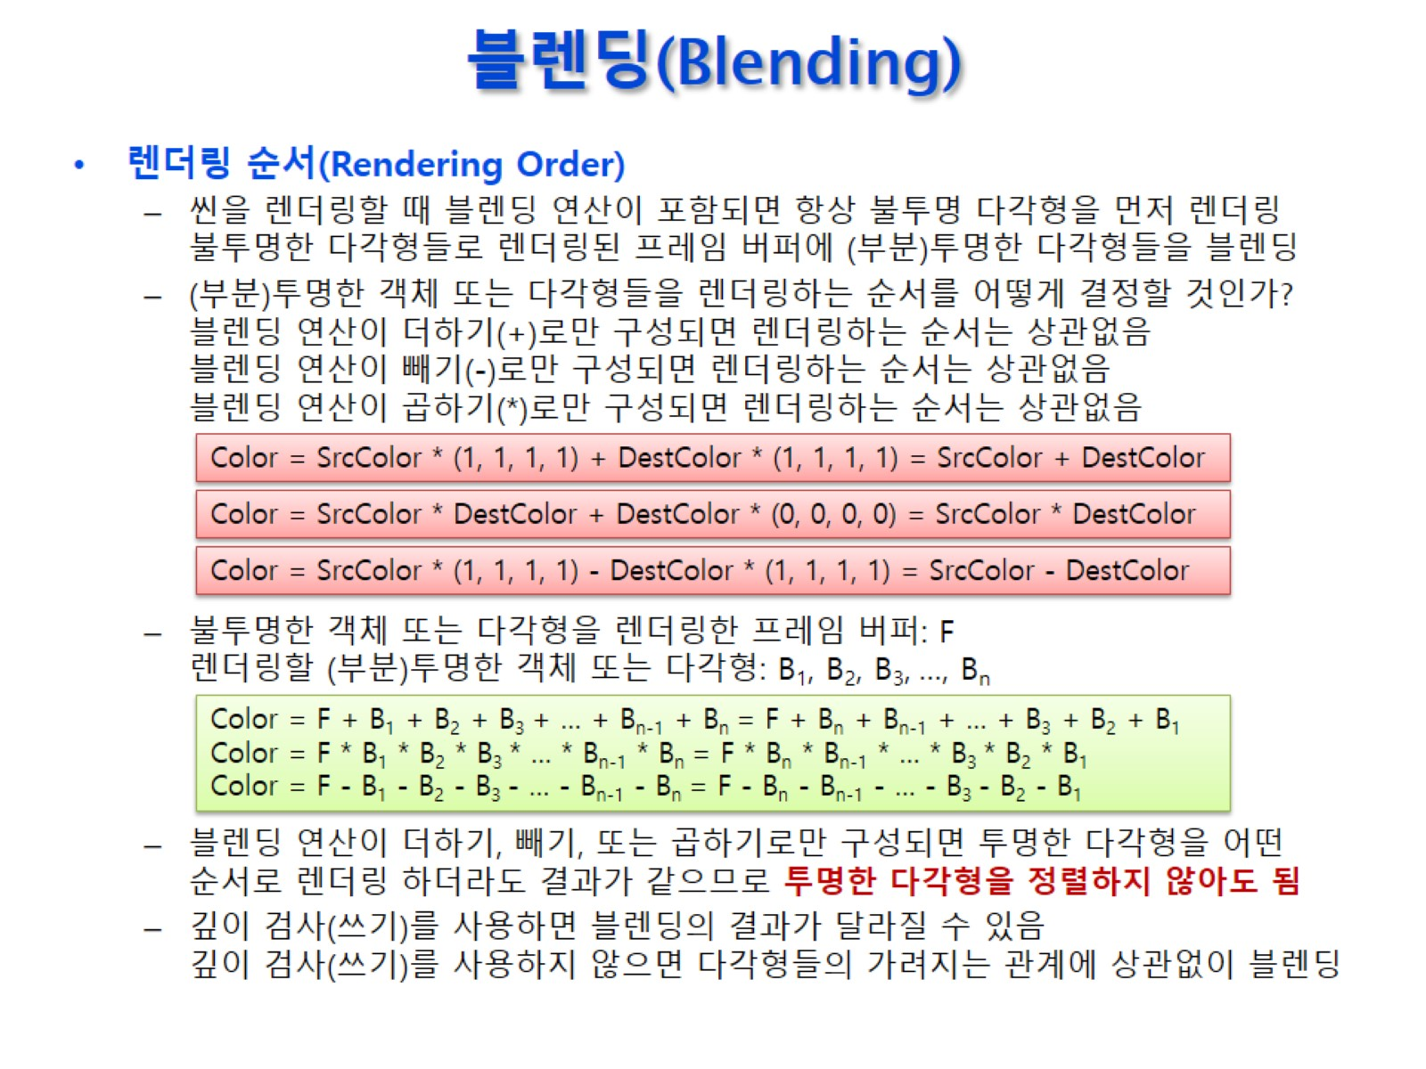
블렌딩(Blending)

Slide 36
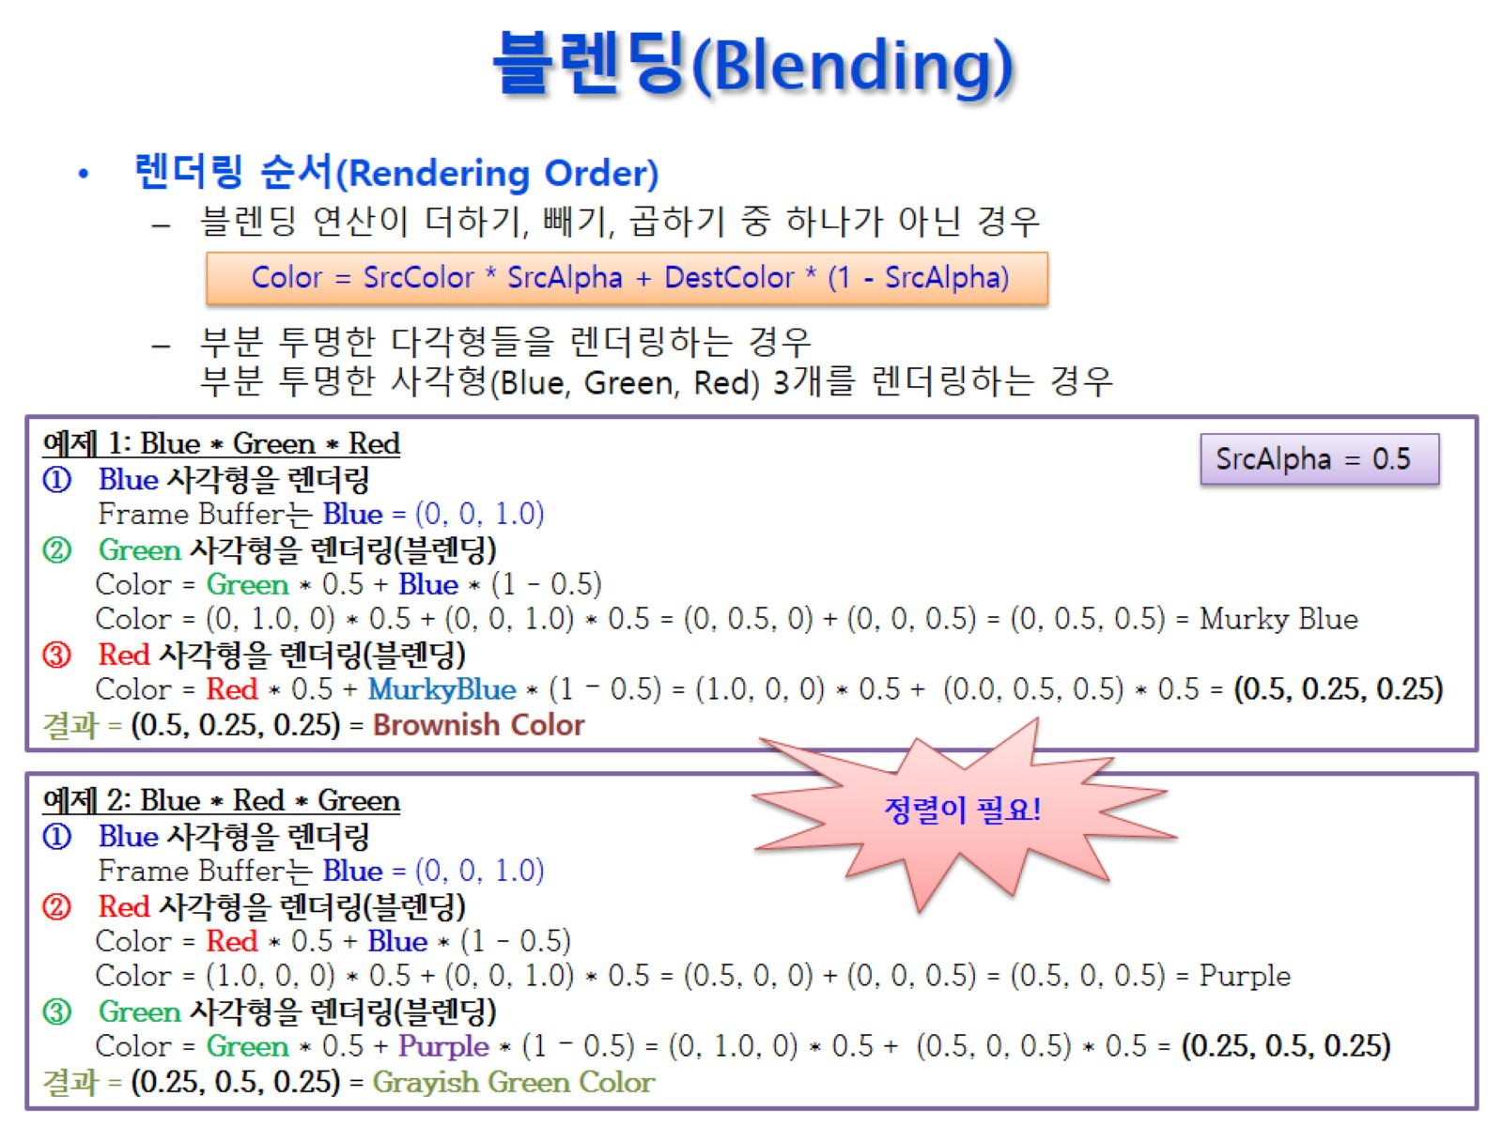
블렌딩(Blending)

Slide 37
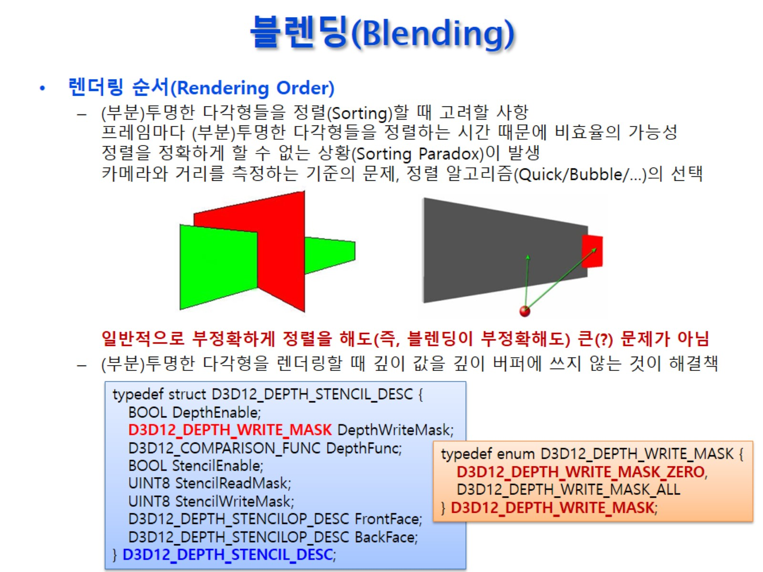
블렌딩(Blending)

Slide 38
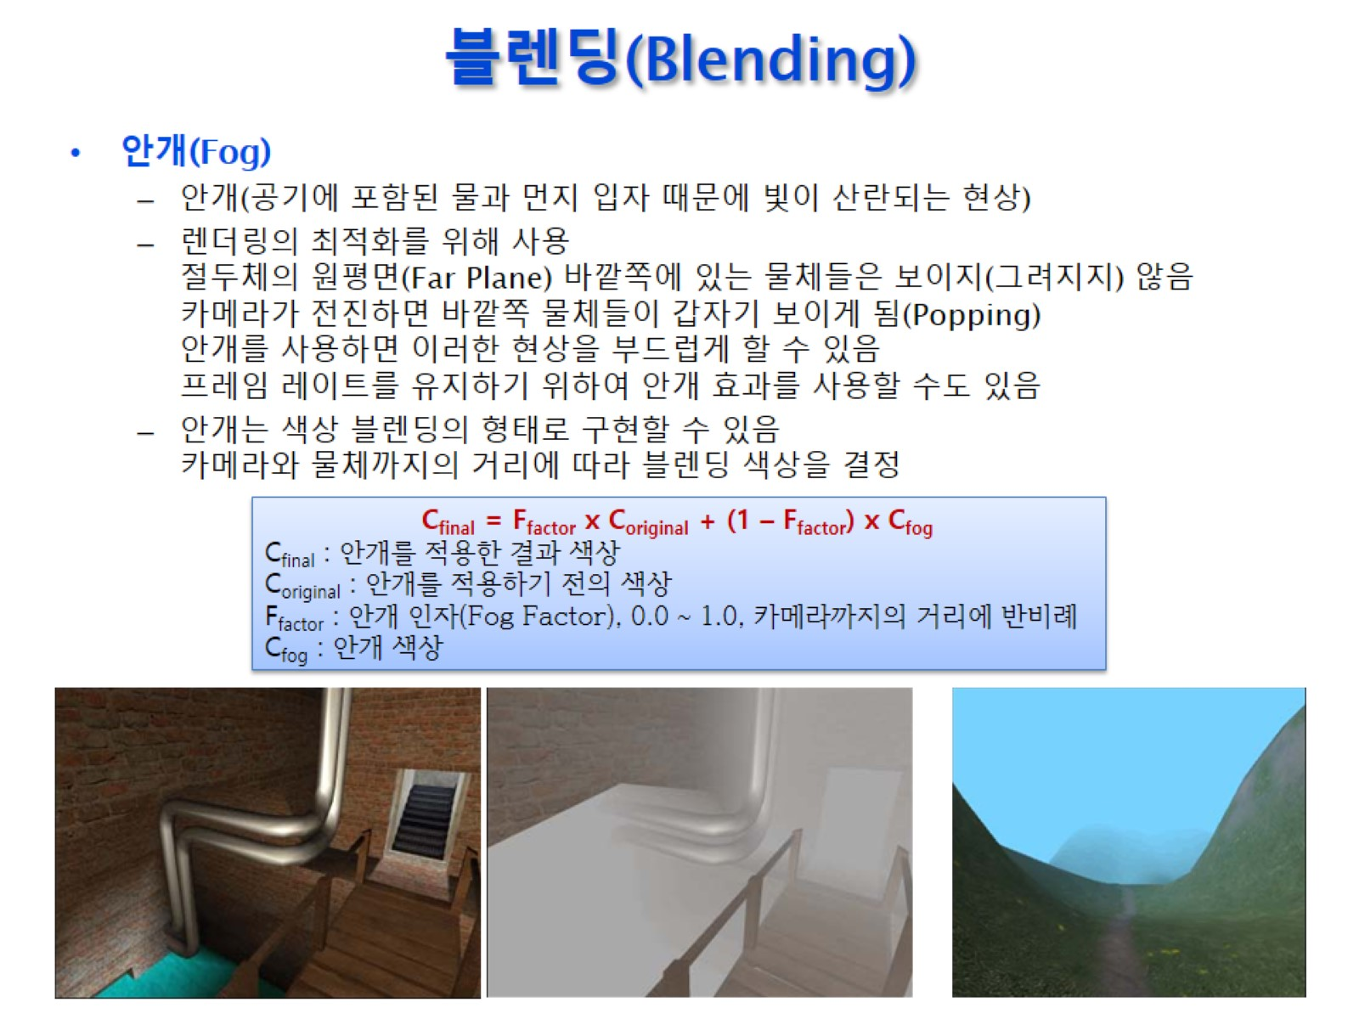
블렌딩(Blending)

Slide 39
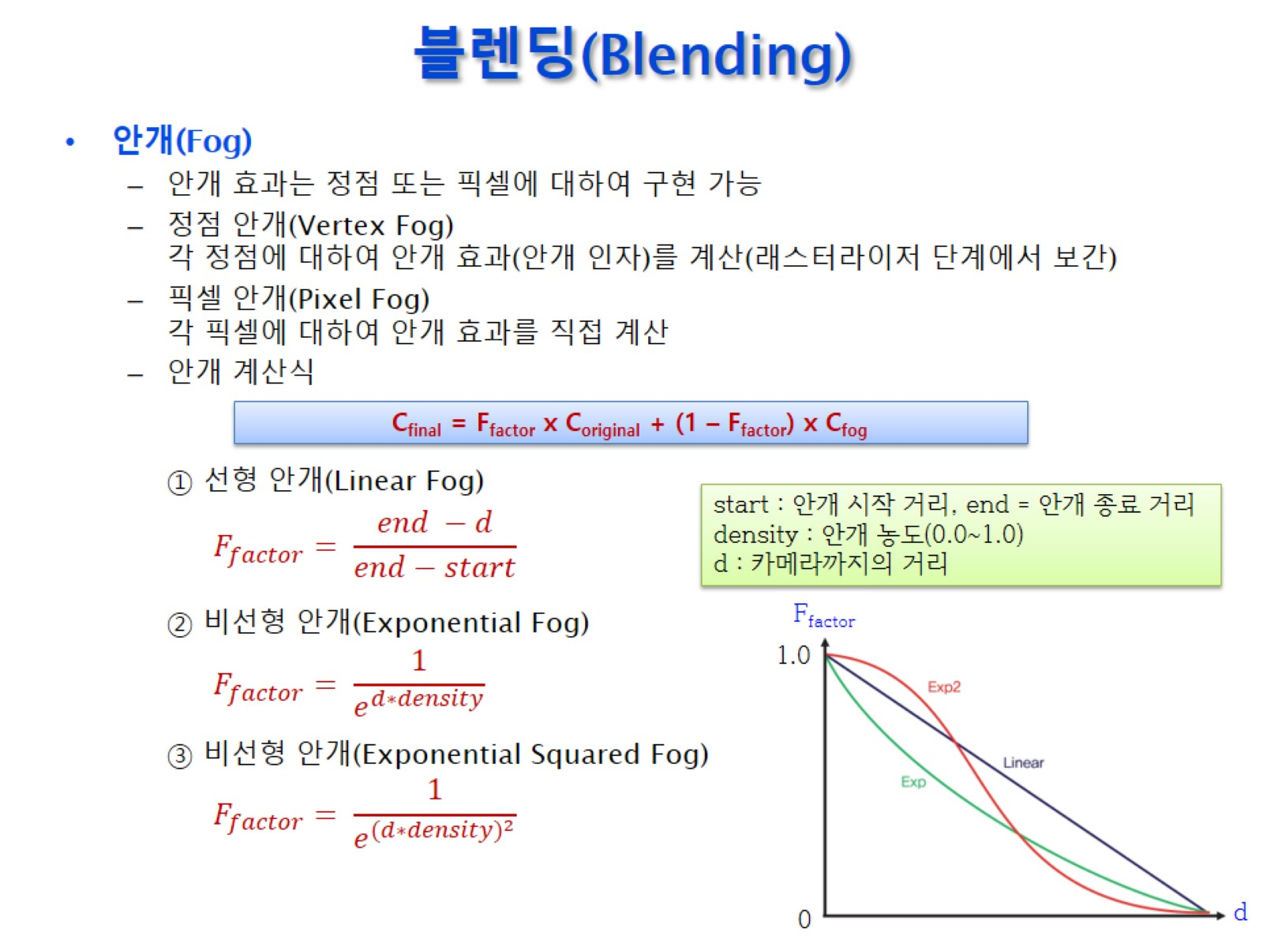
블렌딩(Blending)

Slide 40
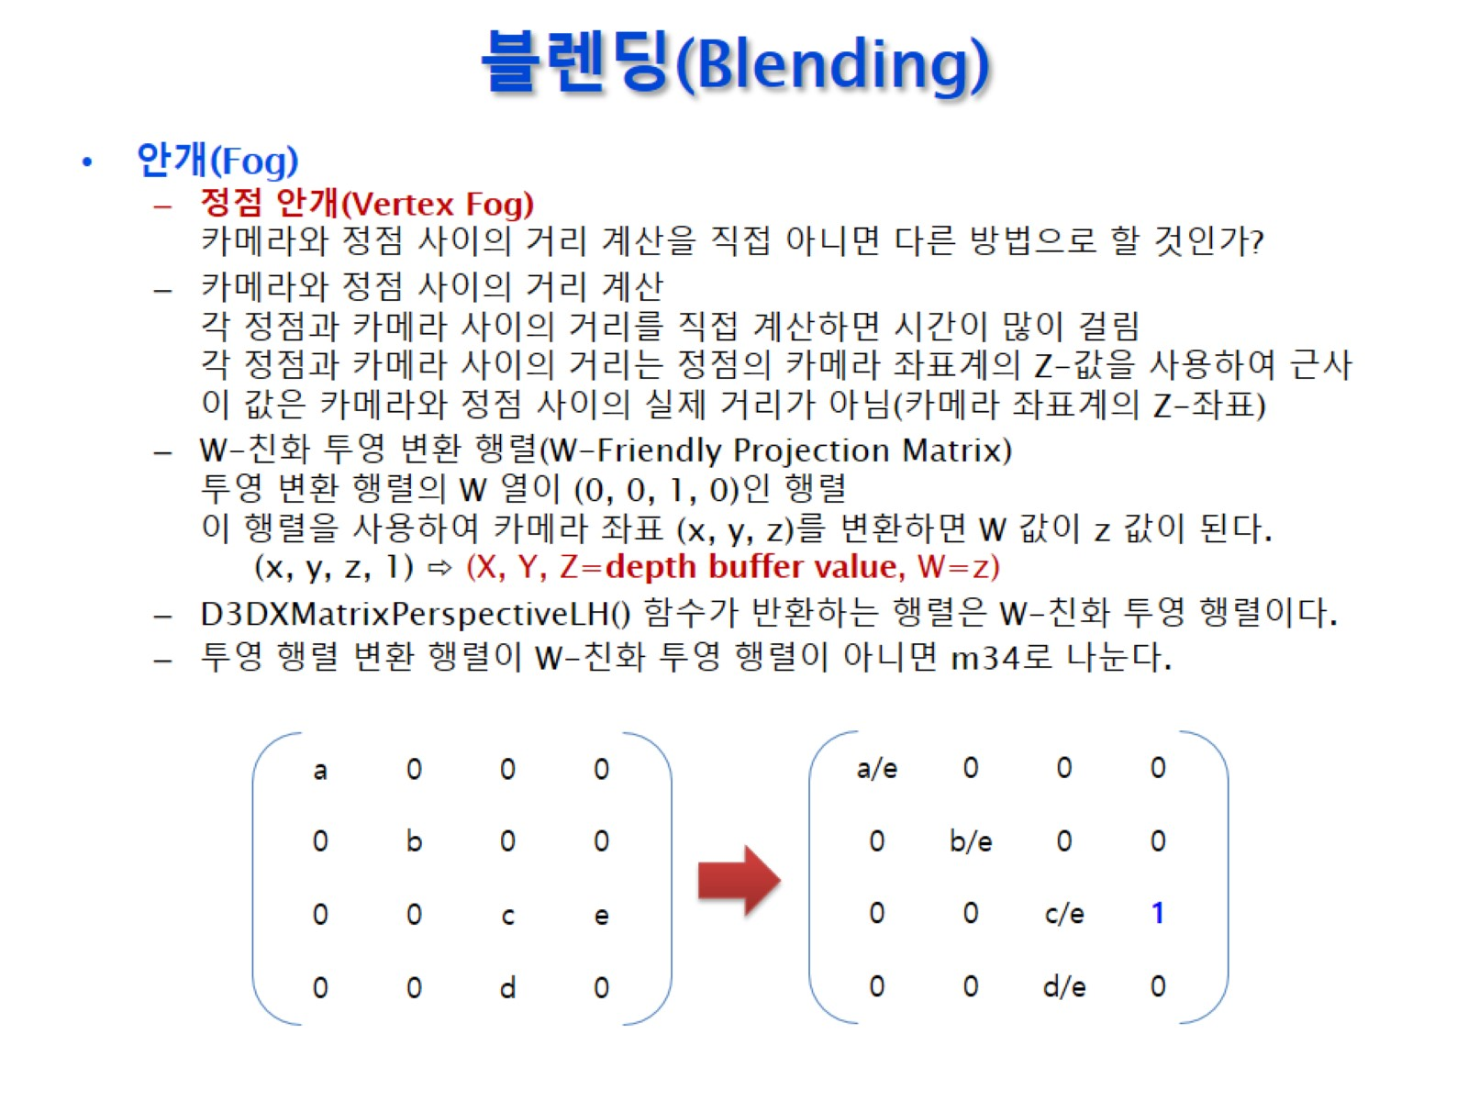
블렌딩(Blending)

Slide 41
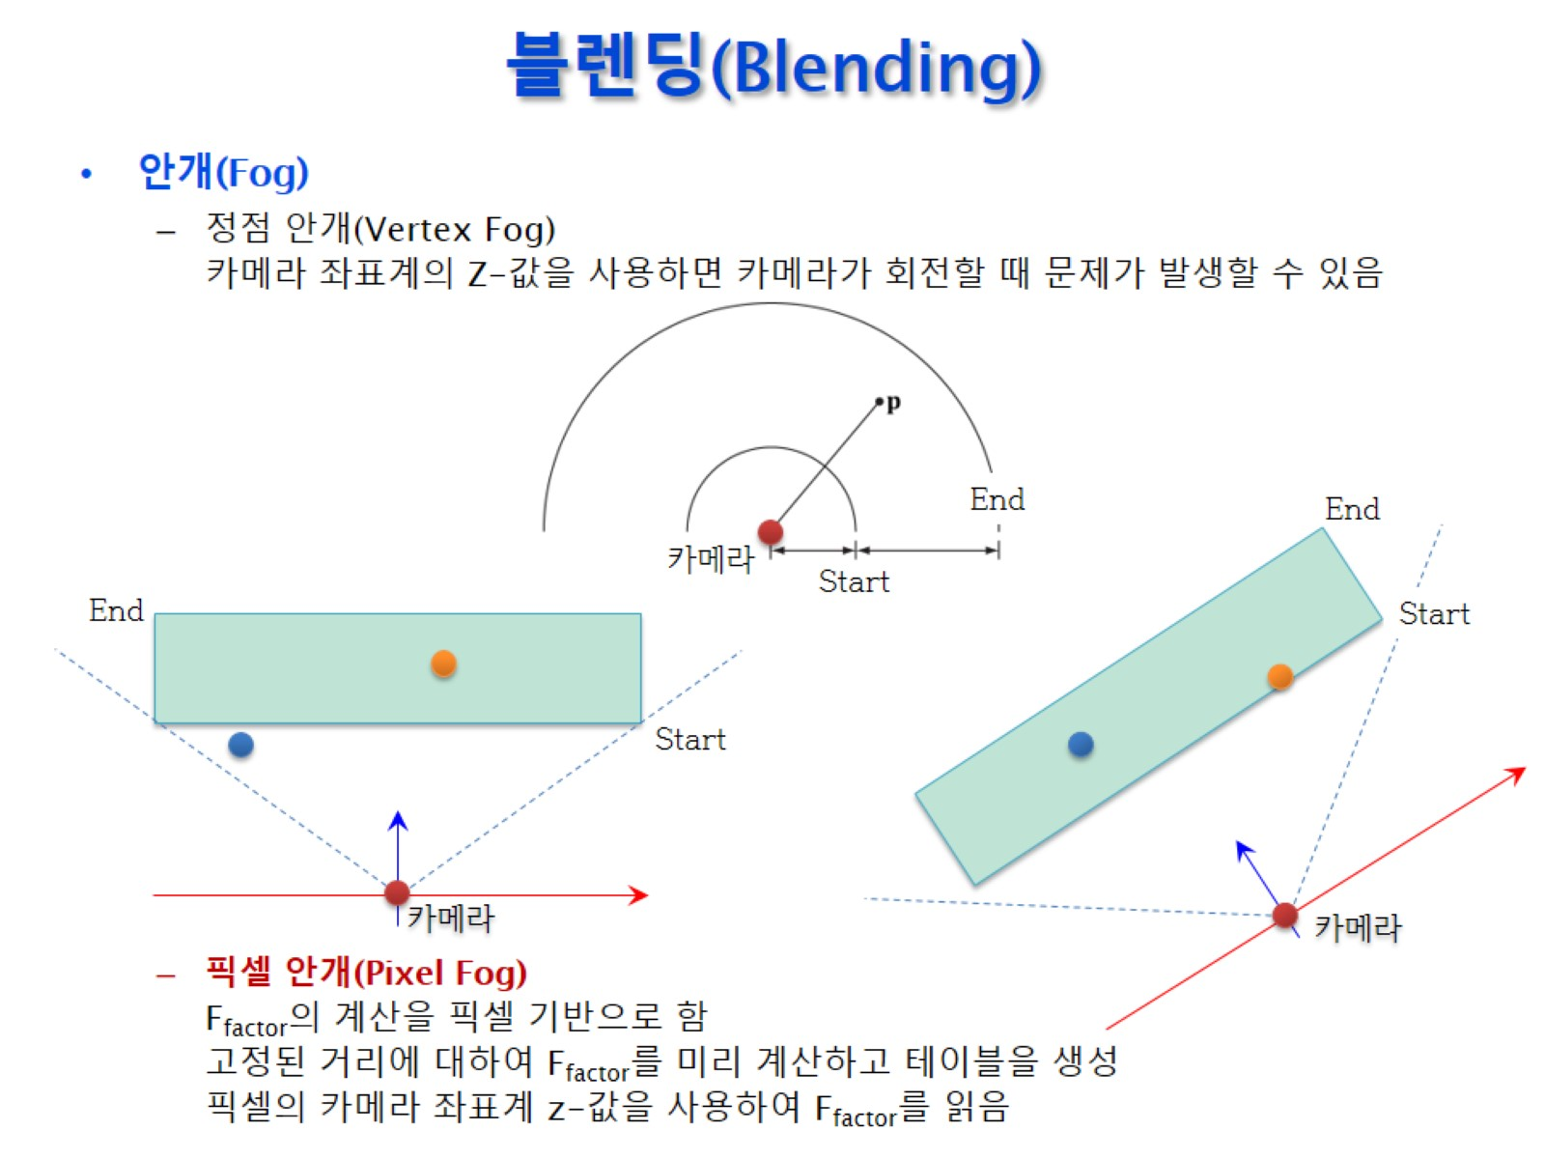
블렌딩(Blending)

Slide 42
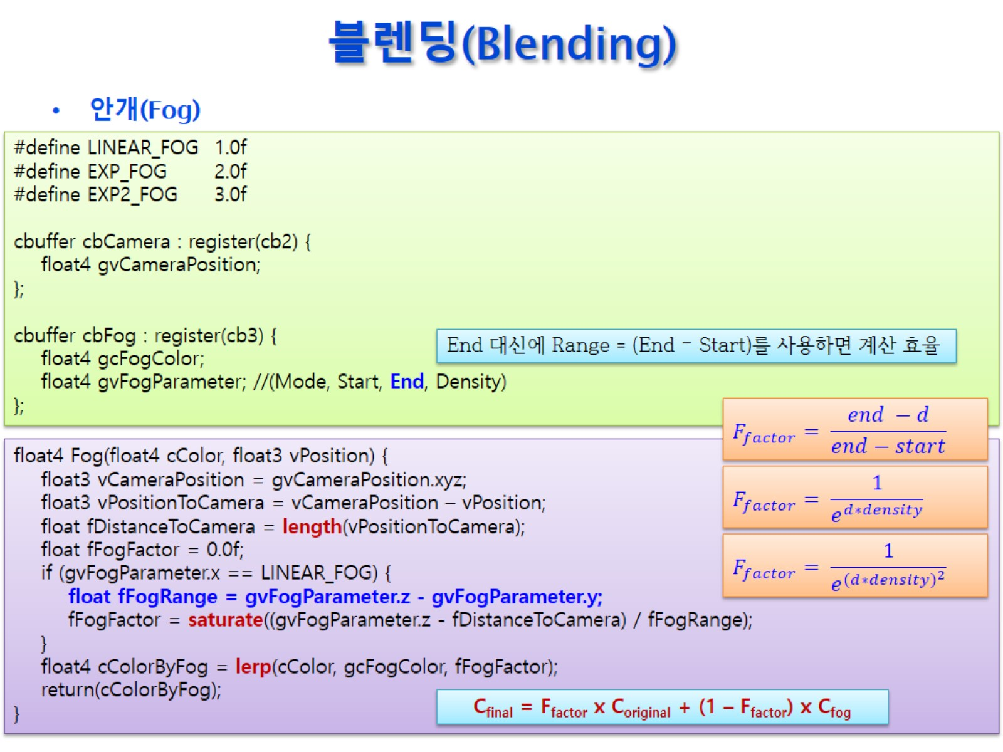
블렌딩(Blending)

Slide 43
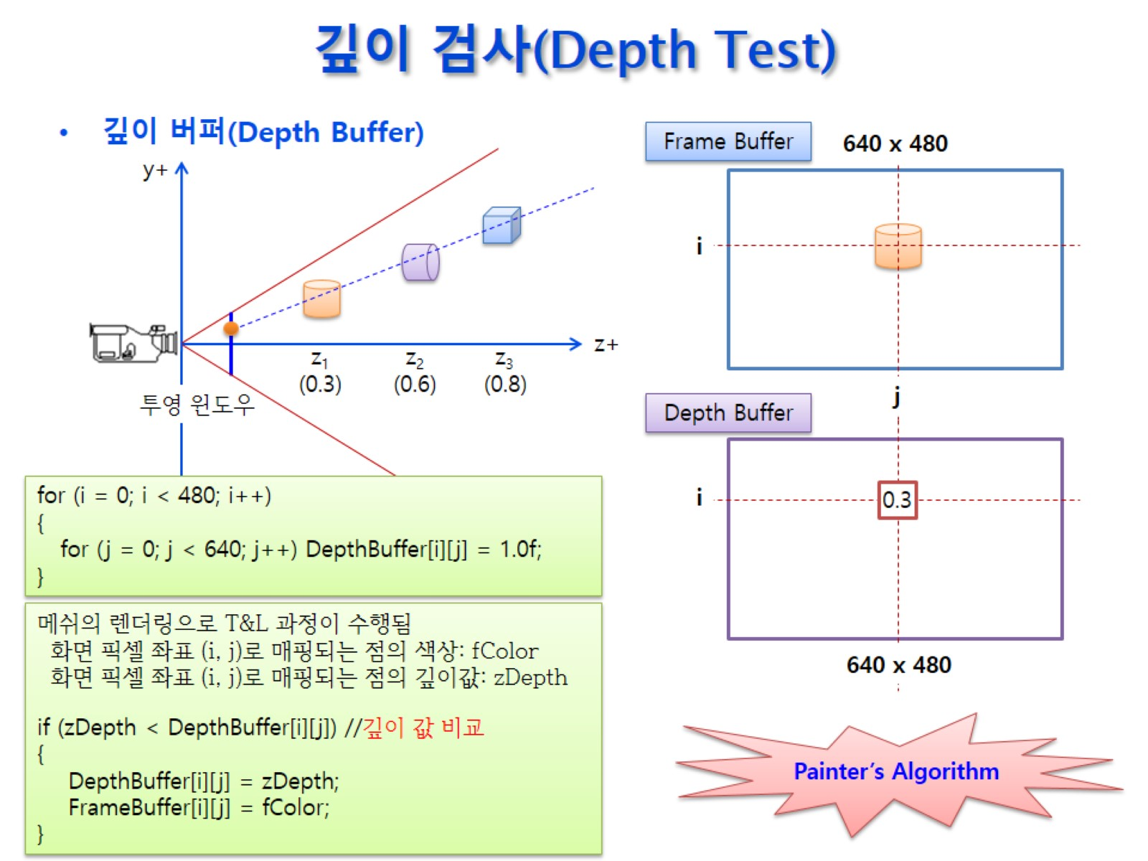
깊이 검사(Depth Test)

Slide 44
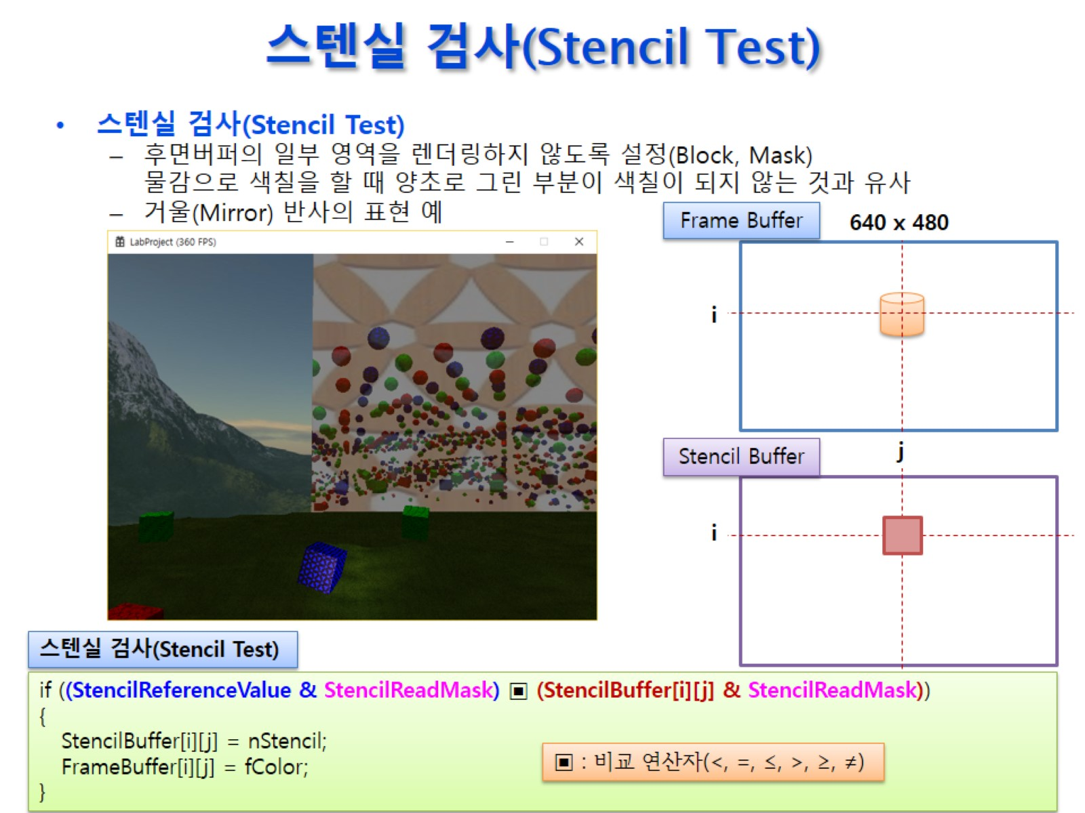
스텐실 검사(Stencil Test)

Slide 45
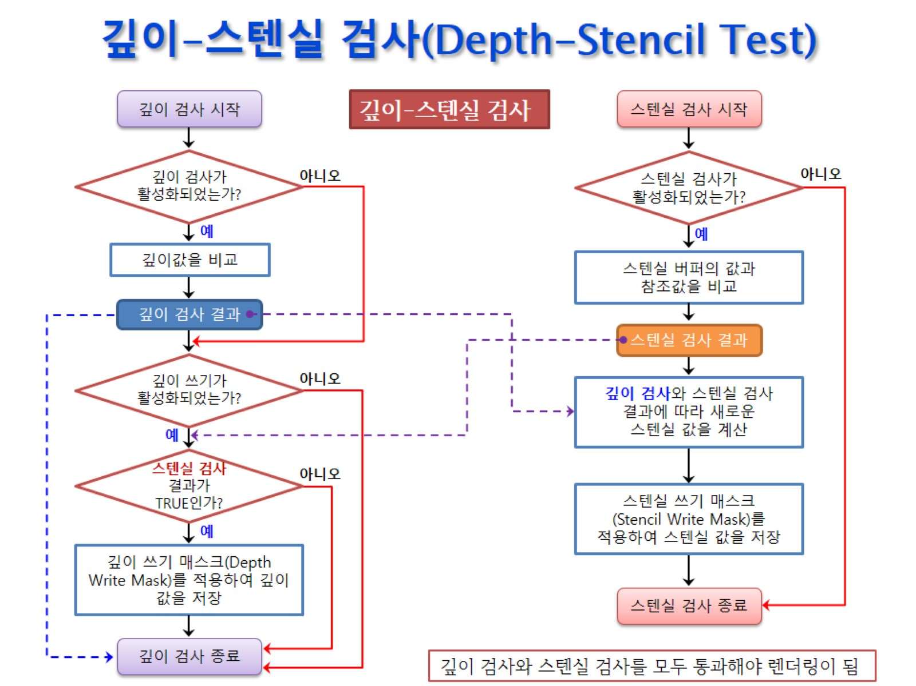
깊이-스텐실 검사(Depth-Stencil Test)

Slide 46
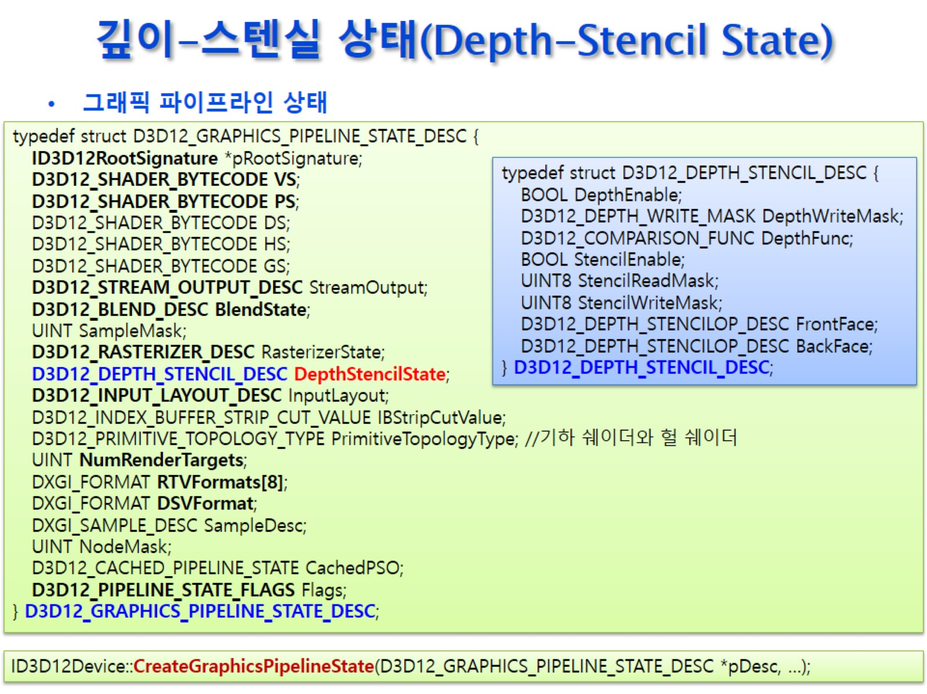
깊이-스텐실 상태(Depth-Stencil State)

Slide 47
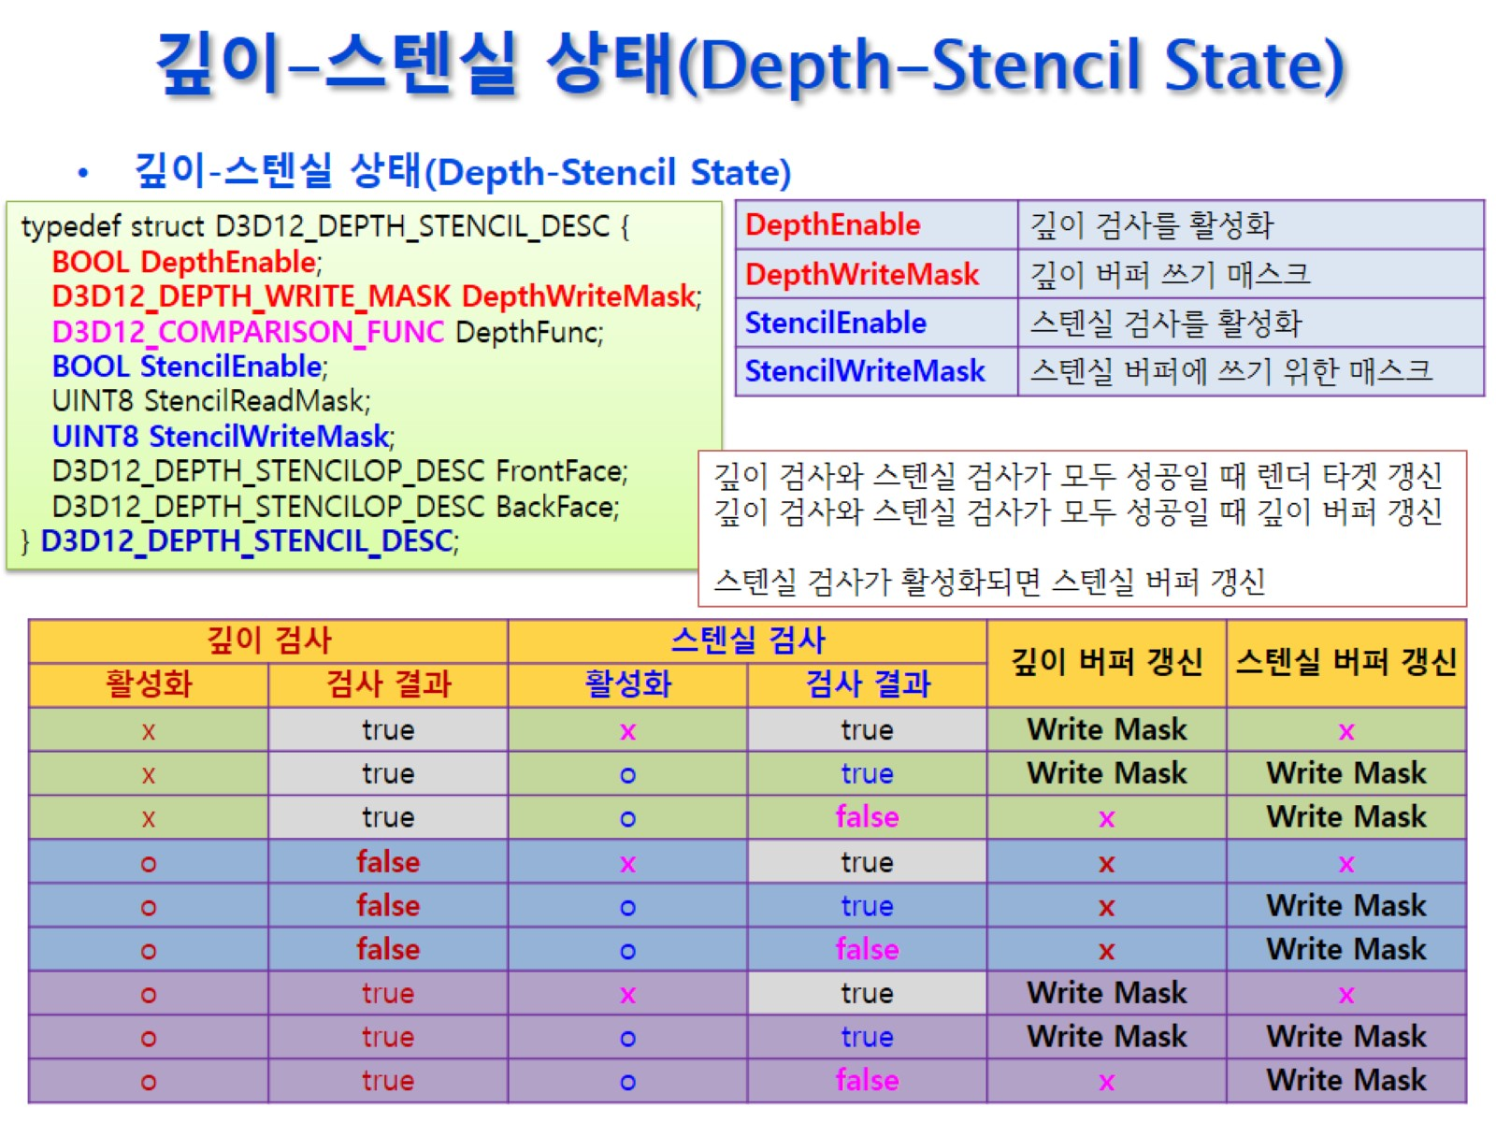
깊이-스텐실 상태(Depth-Stencil State)

Slide 48
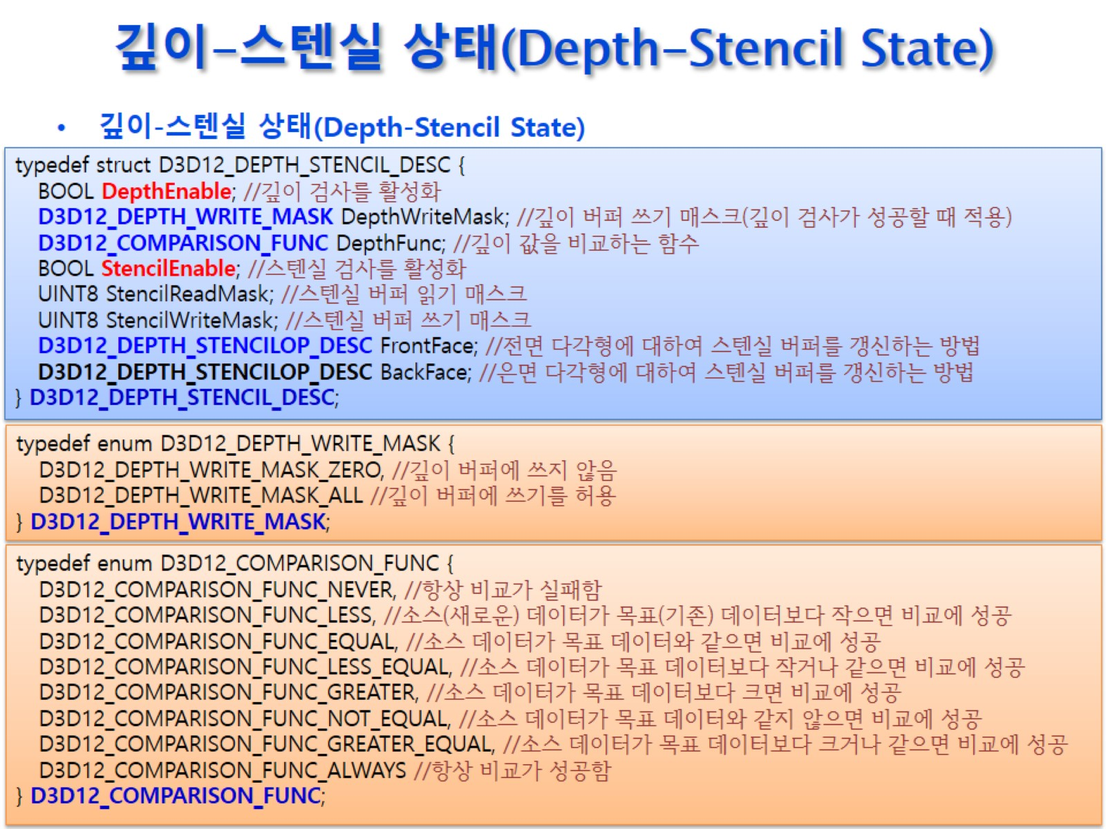
깊이-스텐실 상태(Depth-Stencil State)

Slide 49
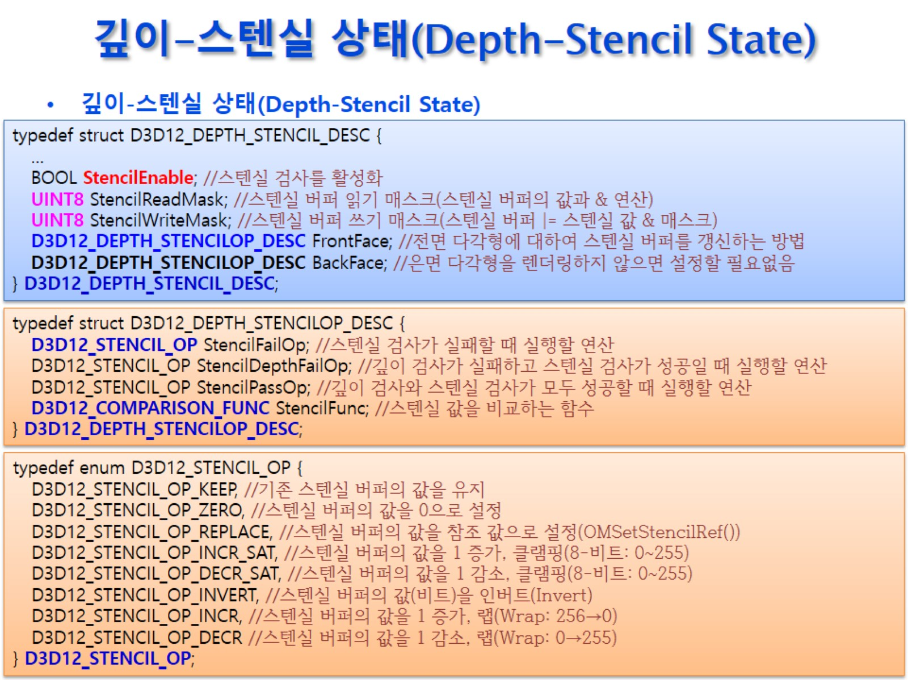
깊이-스텐실 상태(Depth-Stencil State)

Slide 50
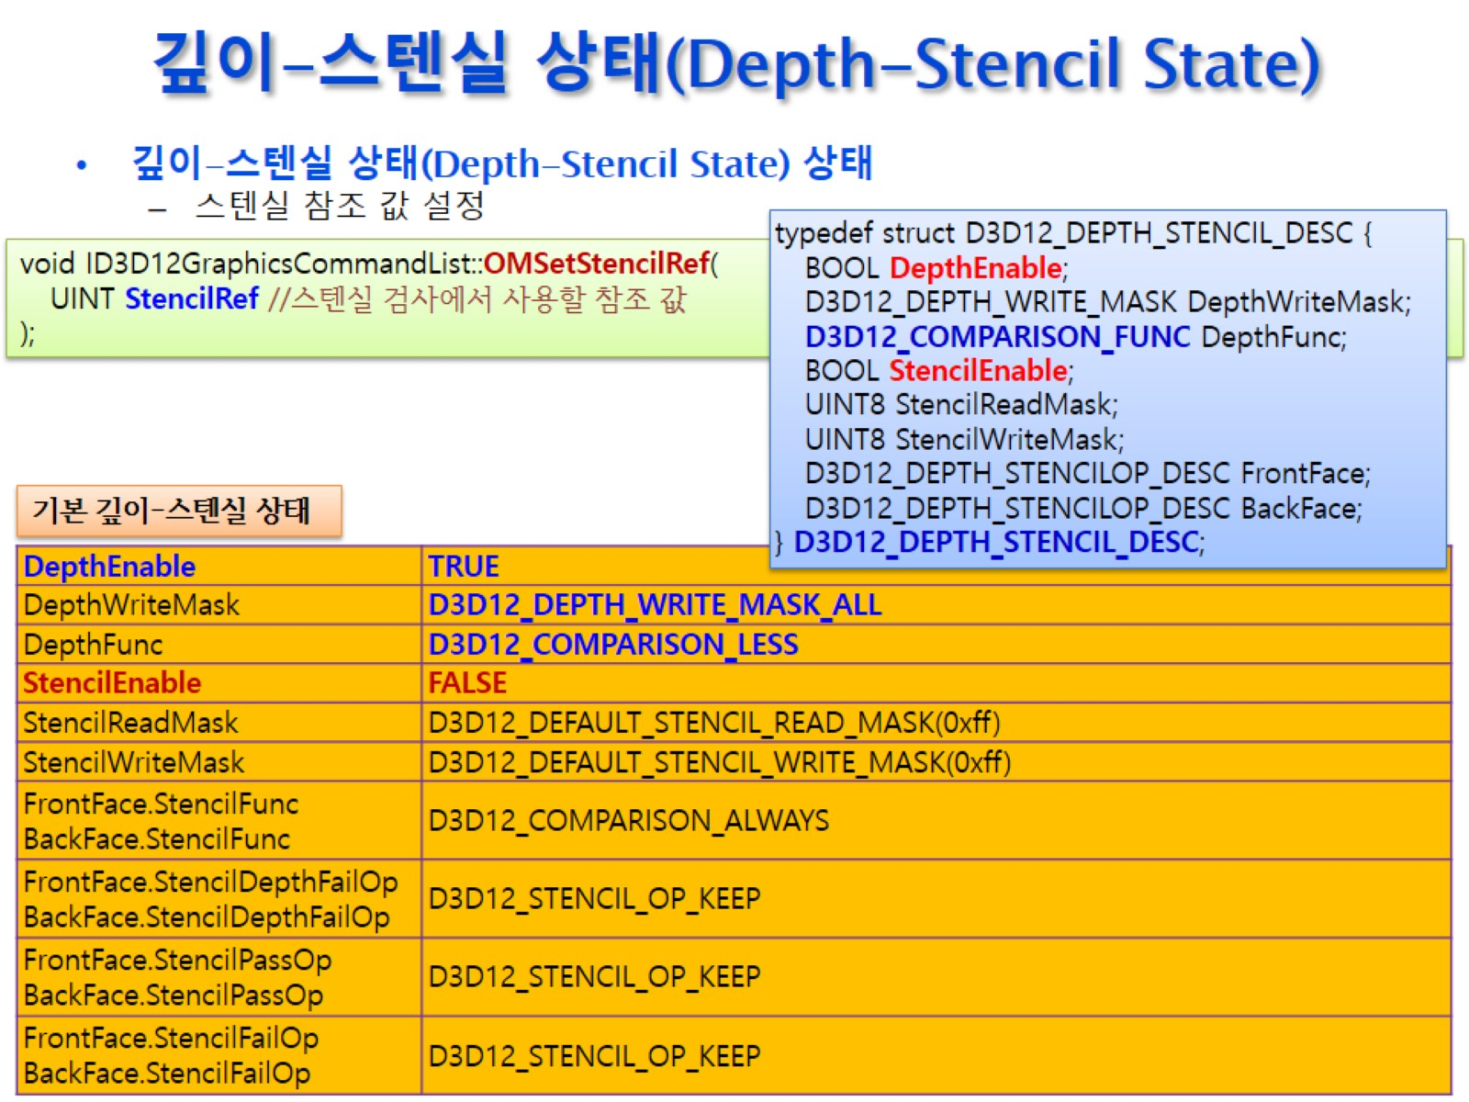
깊이-스텐실 상태(Depth-Stencil State)

Slide 51

깊이-스텐실 뷰(Depth-Stencil View)

Slide 52

깊이-스텐실 뷰(Depth-Stencil View)

Slide 53

깊이-스텐실 뷰(Depth-Stencil View)

Slide 54

깊이-스텐실 뷰(Depth-Stencil View)

Slide 55

깊이-스텐실 뷰(Depth-Stencil View)

Slide 56

깊이-스텐실 뷰(Depth-Stencil View)

Slide 57

깊이-스텐실 뷰(Depth-Stencil View)

Slide 58

깊이-스텐실 뷰(Depth-Stencil View)

Slide 59

스텐실(Stencil) 응용

Slide 60

스텐실(Stencil) 응용

Slide 61

스텐실(Stencil) 응용

Slide 62

스텐실(Stencil) 응용

Slide 63

스텐실(Stencil) 응용

Slide 64

스텐실(Stencil) 응용

Slide 65

스텐실(Stencil) 응용

Slide 66

스텐실(Stencil) 응용

Slide 67

조명(Lighting)

Slide 68

스텐실(Stencil) 응용

Slide 69

스텐실(Stencil) 응용

Slide 70

스텐실(Stencil) 응용

